Slide 1
Service learning: synergy of teaching and learning, research and community engagement
Sunitha C Srinivas
Faculty of Pharmacy, Rhodes University, Grahamstown, South Africa 6139

Slide 2
Service-learning: a key outcome
Service learning- an excellent tool that steers one away from the traditional ‘disease-drug-dispense’ model in pharmacy education
Provides an “enabling” space that intersects Teaching and learning, Research and Community engagement
Provides enormous opportunities for the development of Critical Cross Field Outcomes for collaborative partnership between learners and educators (http://pcqs.saqa.org.za/showUnitStandard.php?id=8607)

Slide 3
Environmental health
Environmental sustainability –Millennium Development Goal 7 http://www.un.org/millenniumgoals/environ.shtml
Intergovernmental Panel on Climate Change 2014 report http://www.ipcc.ch/
Environmental health - an extremely important area that needs to be introduced into the curriculum for training future pharmacists based on the major health impact of current environmental damage http://www.who.int/topics/environmental_health/en/
Health justice of the marginalized population in developing countries
Educator - innovatively create active learning environments for local issues

Slide 4

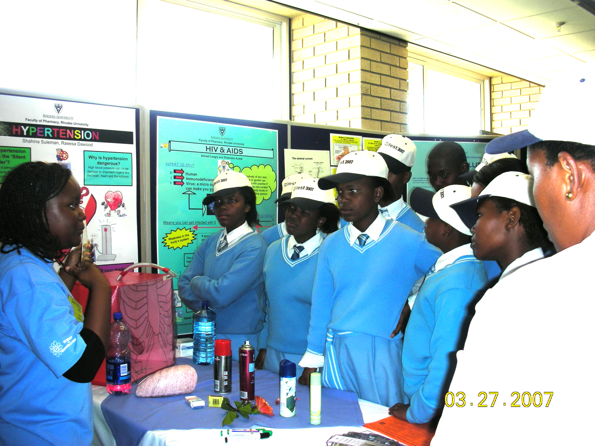
Scifest 2007

Slide 5
National Science Festival (Scifest)
Past experiences -Scifest
Service-learning project on environmental health for fourth year pharmacy students
Topics 2014: Plastic and Litter, Water Conservation and Safe Disposal of Medicines
Encompassed the goals of South Africa’s Council of Higher Education and Rhodes University in the areas of service-learning, research, and teaching and learning
Scifest health promotion project from 12-18 March 2014 by three final year pharmacy students.
Proactive assistance of a colleague from the Computer Science department at Rhodes University resulted in designing a software program to create a computer based pre-post educational intervention for the participants

Slide 6
Method
1241 participants for the computer based pre-intervention phase.
Learners from Eastern Cape government schools and above 11 years
Others interacted with the pharmacy students and a Sci-friend at the health promotion exhibit
Discussion related to the impact of environmental health and the collective actions of individuals and communities.
Visual aids for communication were designed in the form of posters, an interactive model and a take-home information leaflet for participants.
A small group instructional diagnosis was conducted for the three pharmacy students by a colleague from the Center for Higher Education Research Teaching and Learning to analyse the benefits of this service-learning project.

Slide 7
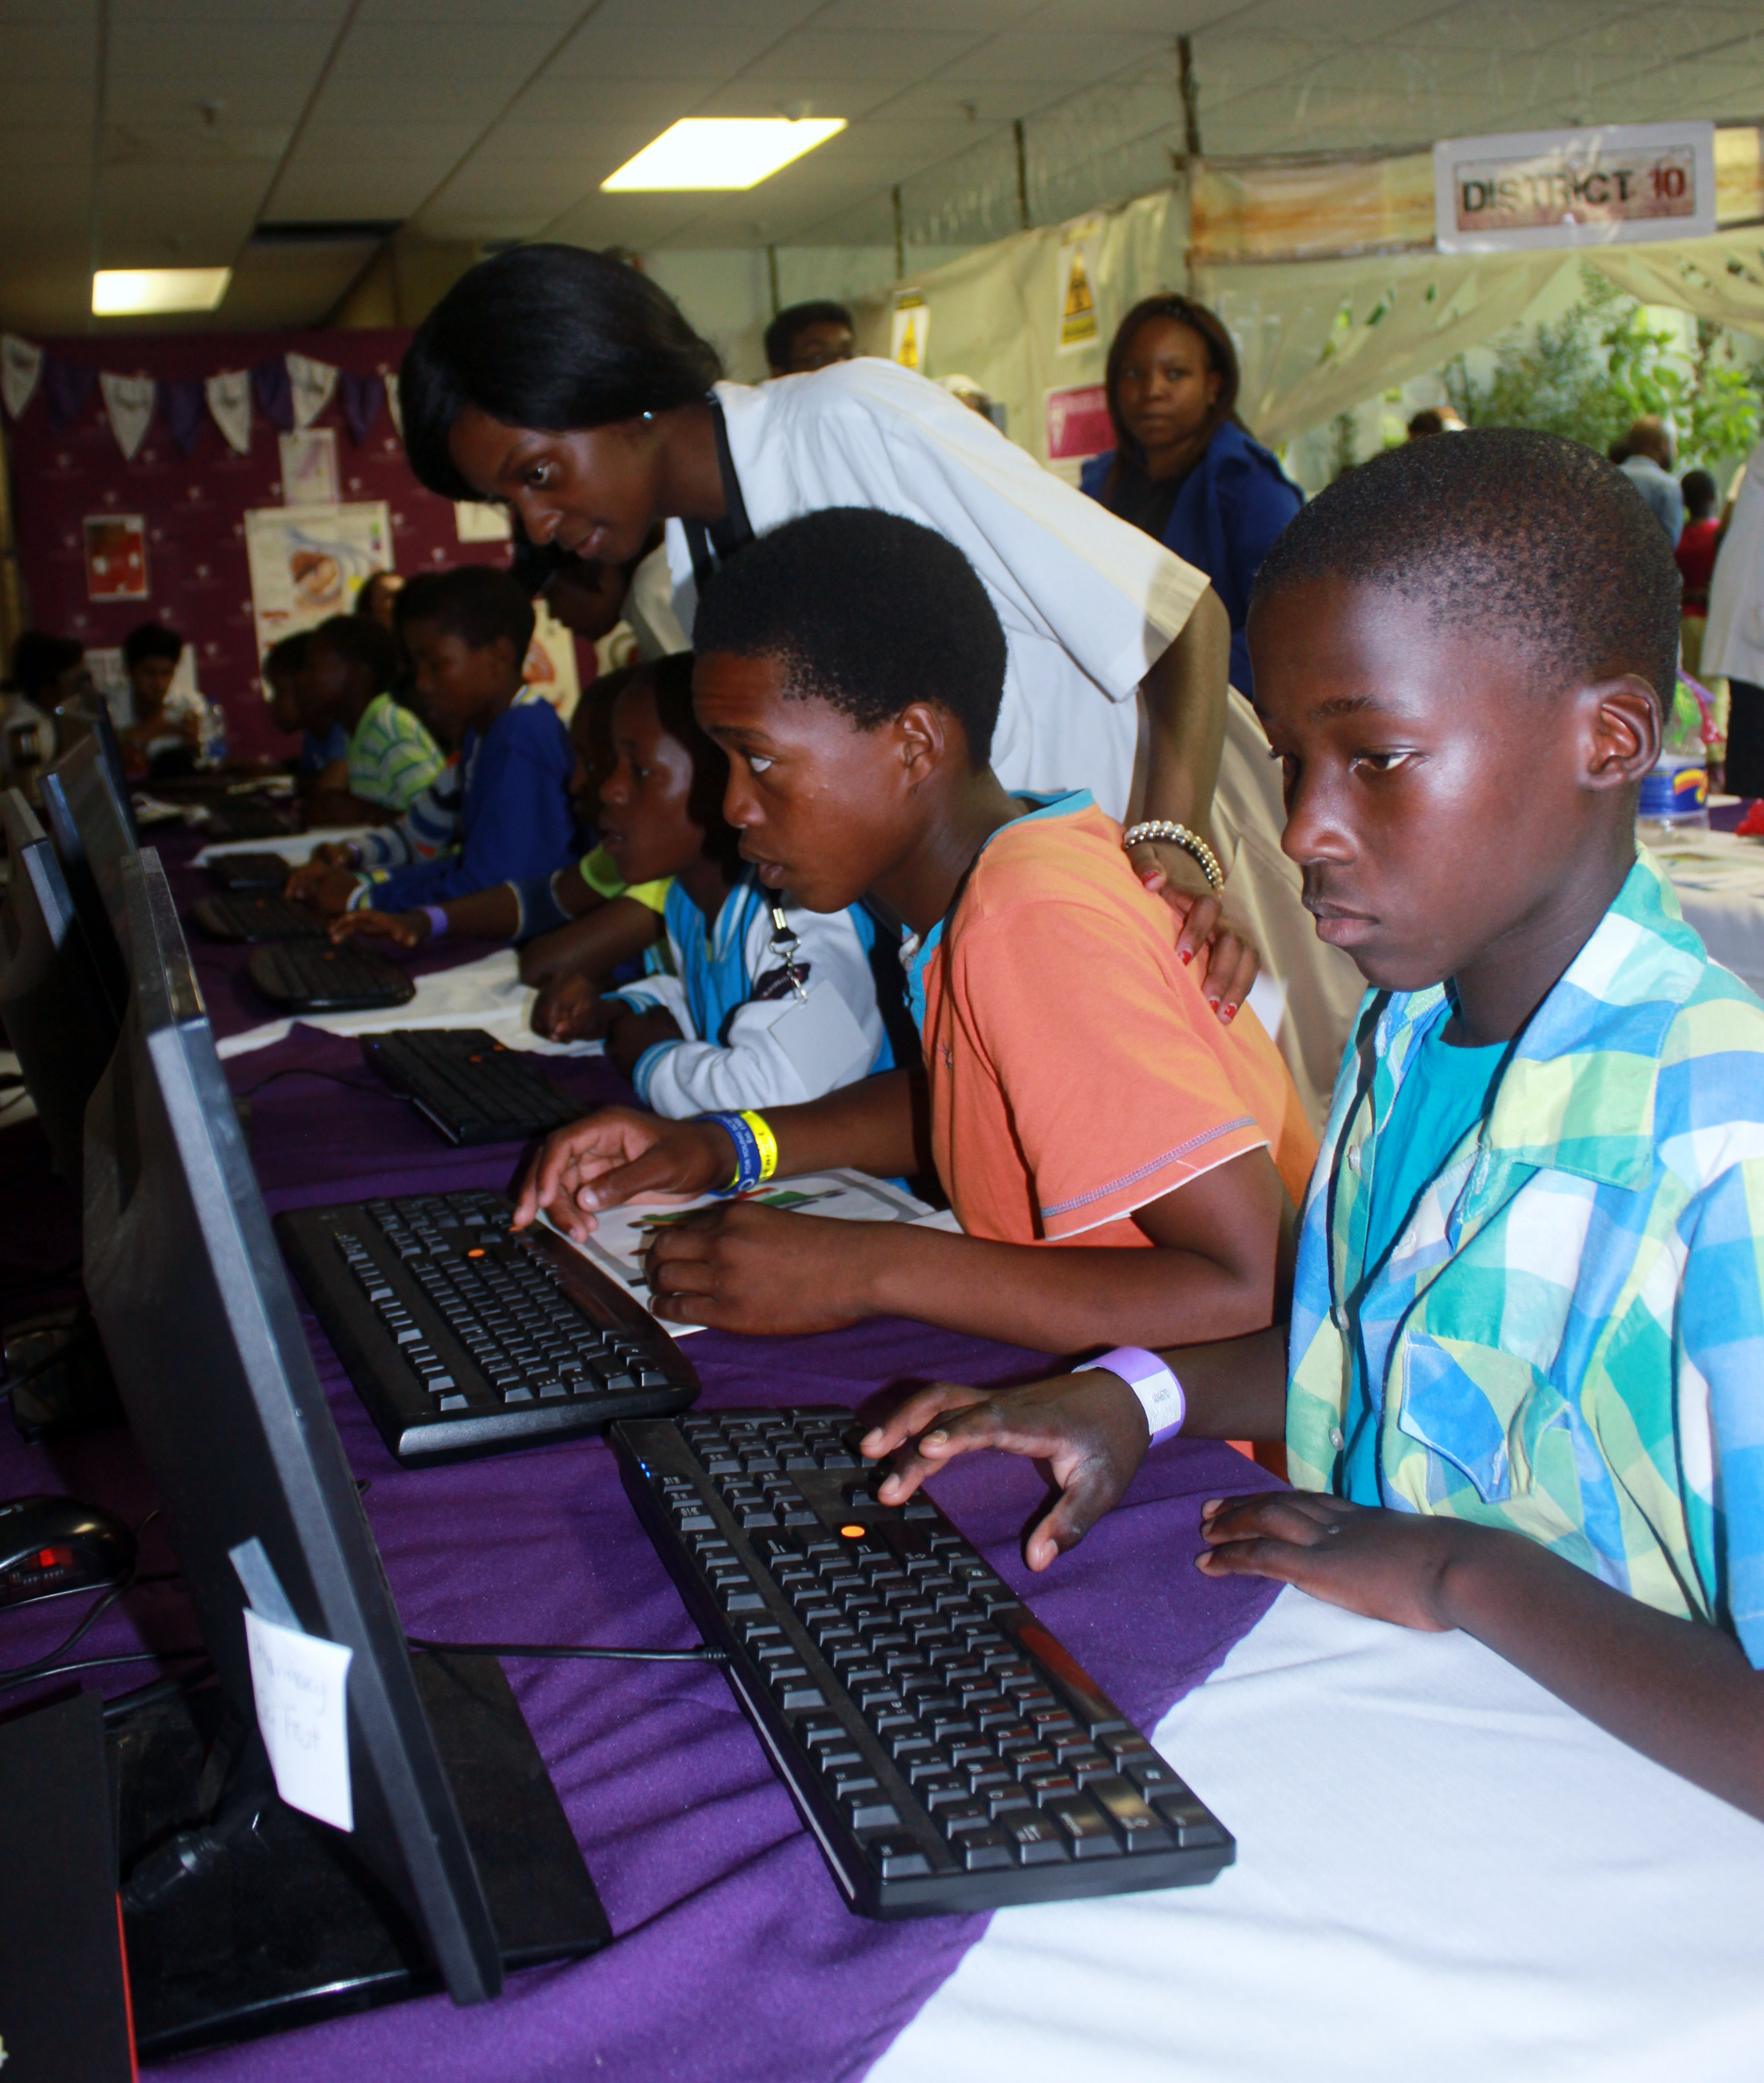
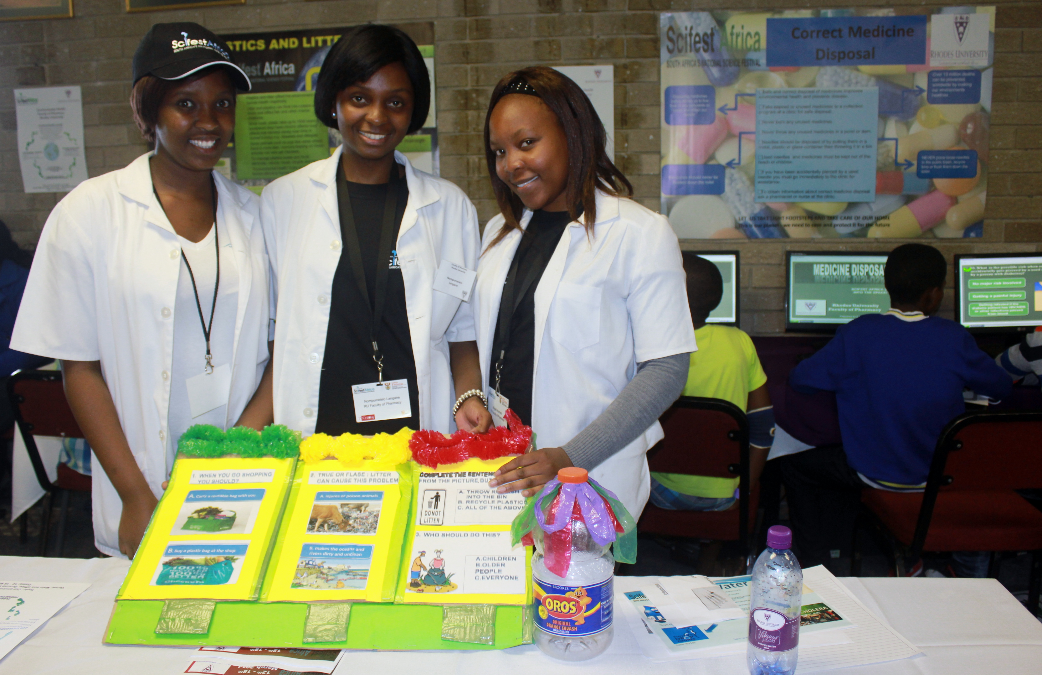

Slide 8
Results
Enthusiastic participants- only three keys on the keyboard that were well-marked by coloured stickers
Pharmacy students reflected very positively on the advantages of a hands-on service-learning project
Improved their critical cross field outcomes such as problem solving, working with technology, communication skills, etc.
http://www.ru.ac.za/latestnews/atwo-wayrelationship.html
http://www.grocotts.co.za/content/news-plus-enviro-two-way-relationship-17-04-2014

Slide 9
Questionnaire and SGID-1
From your involvement in the Scifest Environmental Health Project, which of the following CCFOs were most applicable?
Two of the three students marked all eleven Critical Cross-Field Outcomes.
One student indicated the following CCFOs:
‘Work in a team’, ‘Organise and manage oneself’, ‘Communicate effectively’, ‘Use science and technology’ and ‘Reflect on and explore effective learning strategies’

Slide 10
SGID 2
Why it is so important?
Two students noted that raising awareness about environmental health by informing learners and teachers was key.
Participation in the education of communities to be a critical part of disease prevention and protection of the environment.
Team work skills are important -the team context allows one to solve problems, as well as reflect, and explore effective learning strategies as a collective.
‘The most important thing was that I participated in every activity, from presenting and interacting with the 10 year olds and using the interactive model, helping the learners with the quiz to using the poster to present to learners and teachers as well. Everything was important to me because I got to interact with people of different age groups and from different backgrounds.’

Slide 11
SGID 3
How will it influence your future practice as a pharmacist?
Effective communication- gaining confidence in speaking with people- all qualities which will influence her future practice.
Another student reflected that SciFest was an ‘eye-opener’, in terms of what people ‘know and don’t know’.
Importance of being culturally and aesthetically sensitive.
Space to practice a variety of problem-solving skills, learning strategies and effective communication skills.
Teamwork - would prove particularly relevant and important in the working environment, as health care professionals ‘need to work together towards a common goal, with the patient as the centrepiece’.
COLLABORATIVE approach- non competitive

Slide 12
SGID 4
Given your experiences in this project describe, with specific details, the benefits of service learning and how it may contribute to social transformation and global citizenship.
• Service learning is beneficial in that you learn by doing, by solving problems with people.
• Service learning offers a platform for learning to the student, through practical work, and allows for a broad understanding of the project issues – for example the correct disposal of medication, plastic and litter pollution and conservation of water resources.
• It gives society an opportunity to play a part in issues that can improve its well-being, in this case issues related to their health – this linking to global citizenship – where every individual plays a role.
• Service learning encourages change: ‘I knew the basics but I never recycled – I’m more responsible now’.
• Service learning mobilises communities. It makes one realise that the community has an important role to play.
• It allows one to use individual knowledge for community upliftment; knowledge is therefore sustainable and you can contribute to change-making.
• Service learning develops critical thinkers and change agents who are able to identify and evaluate problems and come up with possible solutions.
• It entails identifying the needs people have, for example access to running tap water, and analysing how that need is met or not met as the case may be.
• Service learning means reaching out to people in the community and forming relationships with them; ‘this increases our levels of sensitivity – culturally and socially.’
• The benefits of service learning are emotional, social and intellectual.

Slide 13
RUPSA- UPSTART
Environmental health promotion initiative -scaled up
Volunteers from the Rhodes University Pharmacy Students Association (RUPSA) and a local Youth Development NGO, Upstart.
A mentoring program -Upstart learners from the Grahamstown township schools who are associated with self-developed by their participation in the President’s Award.
Staff liaison of RUPSA and a long-term associate of Upstart- mentoring program
Four outreach formats: using the newspaper they publish, the radio program they organise, a film they produce or a poster to reach out to their communities of choice.
Each Upstart member will chose the community they want to reach out to – their school, their peers, their families, or larger communities.

Slide 16
Discussion
Guiding principles of Rhodes University: teaching and learning, community engagement, and research
Additional platform - trans-disciplinary nature in using Information and Communication Technology (ICT) to benefit learners mostly from government schools with limited resources in the Eastern Cape, as well as to use ICT in a non-computer science discipline.
The creation of a program that allows educators in the target discipline to input their information in a simple, yet effective way for increasing advocacy of important issues of environmental health that requires increased awareness and conscious actions by community members is a major advantage.

Slide 17
Activities and Technology
Hands-on activities for students to design, collaborate with computer science department and implement this computer based pre-post intervention health promotion has been published and is enclosed below
Sunitha C Srinivas, Wendy Wrench, Karen Bradshaw, Natisha Dukhi. HIV/AIDS: Preliminary Health Promotion Activity Based on Service-Learning Principles at a South African National Science Festival. Indian Journal of Pharmaceutical Education and Research, 2013; 47(1):106-112
Srinivas SC; Wrench W; Bradshaw K; Dukhi N. Diabetes mellitus: preliminary health-promotion activity based on service-learning principles at a South African national science festival. Journal of Endocrinology, Metabolism and Diabetes of South Africa. 2011,16 (2):101-106.
Sunitha C Srinivas, Wendy Wrench, Catherine Karekezi, Sarah Radloff, Santy Daya. Obesity: A baseline health promotion intervention of an introductory service-learning course for pharmacy students. Health SA Gesondheid, 2009, 14(1). Available http://www.hsag.co.za/index.php/HSAG/article/view/454/434
Design, implementation and evaluation of this service-learning activity has also been published
Catherine W Karekezi, Wendy Wrench, Lynn Quinn, Dina Belluigi, Sunitha C Srinivas. Design, Implementation and Preliminary Evaluation of a New Service-Learning Elective for Pharmacy Students. Education as change, Special Issue: Community Service Learning, 2007, Dec: 11 (3): 143- 56.
Srinivas SC, Wrench W. Evaluation of a service-learning elective as an approach to enhancing the pharmacist’s role in health promotion in South Africa. African Journal of Health Professions Education, 2012, 4(2):107-111.
Sunitha C. Srinivas, Wendy Wrench, Karen Bradshaw, Catherine Karekezi. Innovation in Education. Using the National Science Festival in South Africa to raise awareness of the prevention of chronic diseases. June 2010, International Journal of Pharmacy. 26 (1): 41-44. http://fip.org/files/fip/IPJ/IPJ_2010V26_web.pdf

Slide 18
THREE pillars of Rhodes University
It is important to note that designing this rewarding service-learning experience has allowed me to combine the THREE pillars of Rhodes University – teaching and learning, research and service-learning. This also provides opportunities to diversify to new areas of outreach, such as Environmental health, carried out in 2015 National Science Festival.
Experiences from the perspective of 2015 Scifest students has been published in
http://www.ru.ac.za/latestnews/atwo-wayrelationship.html
http://www.grocotts.co.za/content/news-plus-enviro-two-way-relationship-17-04-2014

Slide 19
Assessment- advantages of mixed methods
Formative feedback is an extremely important assessment tool that I use to facilitate and support creativity amongst students when developing new methods/tools
Summative feedback based on assessment grids provided upfront by myself, which is also discussed and clarified, assists my students to work towards their goals while they link the objectives to the tasks and then to the assessment

Slide 20
Innovations, influence, wider impact
Delving deeper and addressing my self-learning is the best aspect of being an educator, that I enjoy the most! The life-long-learning as an educator keeps me absolutely inspired.
Reading around service-learning, experimenting and finding new ways of outreach towards the community especially in areas of health promotion (rather than ‘disease-drug-dispense’ route) has resulted in simple but effective innovations of trans-disciplinary computer based service-learning
Publishing in the area of scholarship of teaching and learning has stimulated more interest for myself, my colleagues and my students. It also has a ripple impact on a larger community.
This has resulted in conceptualisation and implementation of community based participatory research in rural villages of Eastern Cape. Outcomes of this project are enclosed below as publications:
Amanda Siruma, Diana Hornby, Sunitha Srinivas*. An assessment of maternal health issues in two villages in the Eastern cape province of South Africa. International Journal of Environmental Research and Public Health 2014, 11(9), 9871-9884; doi:10.3390/ijerph110909871. Available http://www.mdpi.com/1660-4601/11/9/9871
Shingirai Katsinde, Sunitha Srinivas, Diana Hornby. The Need for Culture Sensitive Participatory Health Promotion Activities To Promote Breastfeeding. Indian Journal of Pharmacy Practice Apr–Jun, 2014. 7(2). http://ijopp.org/article/350
Kuzeeko F, Hornby D, Srinivas S. Countdown to 2015: State of Millennium Development Goal 4 in India and South Africa. Indian Journal of Pharmacy Practice, July-Sep 2013, 6 (3):2-7.
Siruma A, Hornby D, Sunitha S. Countdown to 2015: Status of MDG 5 in India and South Africa. Indian Journal of Pharmacy Practice, 2012, 5(4): 1-7. Available http://ijopp.org/oct_dec_2012/4-10.pdf
Faith Kuzeeko, Amanda Siruma, Diana Hornby, Sunitha Srinivas. Countdown to 2015: evaluating millennium development goals. International Pharmacy Journal, 2012, 28 (1): 50-58.

Slide 21
Conclusion
Trans-disciplinary service-learning based research case study
Create a software platform that can be used by those with very little computer literacy
Strengths of combining service-learning, research and teaching for a wider benefit
Positive consequential effects of such participatory environmentalism on learners, teachers and community members alike are encouraging.

Slide 22
THANK YOU

