Slide 1
Achieving Quality Tertiary Education in Botswana: The Significance of a Constructive Alignment between Curriculum, Pedagogy and Assessment

Slide 2
Outline of the Presentation
Background
Factors pushing for Quality education
Botswana response to Challenges in Education
Judging Relevant Education
How ready is the Education system?
What needs to be Done?
Constructive Alignment and Employability
Implications

Slide 3
Background
Quality education has taken centre stage in the last 20 years
In Botswana the 2008 Tertiary Education Policy (TEP) articulated the challenges facing tertiary education and the issues to attend to.
Among these was “Relevance” – the extent to which tertiary education addressed societal and economic challenges of the country.
To address the challenge of ‘relevance’ Govt. has created the HRDC, BQA, BEC etc.

Slide 4
Factor(s) pushing for Quality Education
Changed Global Economic Environment
  Increased global Competitiveness resulting from Globalisation – “footloose’ capital.
A restructured Workplace since the 1980s
  New patterns of production (e.g. decentralised, flattened hierarchies, segmentation).
Emergence of a ‘New” Worker – Castell’s “Self-programmable worker.
  Has these characteristics: (S)he is multi-skilled: Adaptability; Flexibility; Problem-solver; Innovative; Critical thinker; Team Player.
  Skill formation is deemed the answer to competitiveness (the supply-side)
Massification
  Resulting in: diverse studentry;

Slide 5
Botswana’s Response
Tertiary Education Reforms aimed at:
  making Botswana ‘a winning and competitive nation’ (Tertiary Education Council 2006, 21). TEC documents are clear about this:
    “Tertiary education institutions around the world are now given a key responsibility for meeting the needs of an increasingly market-driven, knowledge-based economy” (Republic of Botswana 2007, 12).
    “a new set of fundamental understandings have emerged which demonstrate a direct causal relationship between tertiary education and societal development . . . Increasingly what is being emphasised is the anchor role of tertiary education in economic and social development. “ (Tertiary Education Council 2006, 17).
    “In general public tertiary institutions have been slow to respond to changes in the labour market, have been poor in terms of establishing linkages with the market . . . Private institutions appear to have been more responsive to the labour market demand. “(Tertiary Education Council 2006, 25).

Slide 6
Botswana’s response (cont’d)
TE, therefore, must be ‘reshaped to become [an] arm of national economic policy’ (Blackmore 1999, 134) or a ‘tool of micro-economic reform’ (Dudley 1998, 36).
In short, the state’s agenda for TE is for the latter to assist in bringing education into the orbit of the economy. It is for this reason that the TEP (2008) harps on the importance of the economy-education nexus. (see also the NHRDS of 2009).
Relevant education, therefore, is one that tightens this nexus.

Slide 7
How do we judge ‘relevant’ education?
By the “Employability” of graduates, defined as “… a set of achievements - skills, understandings and personal attributes – that makes graduates more likely to gain employment and be successful in their chosen occupations, which benefits themselves, the workplace, the community and the economy. (Yorke, 2006:8)
this requires 2 attributes,
  meta-cognitive skills such as learning how to learn
  behavioural attributes, such as ability to take responsibility for managing one’s own performance at work and career development (Harvey et al. 1997).
These attributes require ‘generic’/‘soft’ skills, such as teamwork, flexibility, adaptability, problem solving, interpersonal competence and critical thinking.
Individuals cannot function effectively in the workplace without these skills. A worker with these attributes is a ‘self-programmable’ worker.
This is the ‘new’ worker to be produced by the education and training sector for a globally competitive economy.

Slide 8
Is our (tertiary) education system producing this learner-worker?
No.
  Observations of a mismatch between the supply-side and the demand-side point to a disconnect.
  “Jobs without people” (which jobs?)
  Employers’ persistent complaints about graduates’ lack of ‘soft skills’.

Slide 9
What’s needs to be done?
At Policy Level
  A coordinated tertiary system with common goals and a strategic plan is required. This is what the TEC/HRDC are working on.
  A well-financed system – HRDC
  Standards are required – BQA
However, policies and other resources get translated into the required products in the tertiary institutions themselves– the providers.

Slide 10
What needs to be done (cont’d)
At Institution Level
  Production of idealised subjects (graduates) takes place through an interaction of 3 things in the classroom: the Curriculum, Pedagogy and Assessment.
  Curriculum is the intended learning outcomes.
  Pedagogy is how the student is expected to learn in order to demonstrate mastery of outcomes.
  Assessment is how the student’s mastery of the outcomes is established/assessed.

Slide 11
Constructive Alignment
For quality education to be realised curriculum, pedagogy and assessment must be aligned to one another.
Biggs (2003; 1999) calls this “constructive alignment”, defined as the “…coherence between assessment, teaching strategies and intended learning outcomes in an educational programme” (McMahon and Thakore, 2006)
In other words “Be clear of what you want your students to learn, how to learn it and how to ascertain that learning has taken place”.
What’s the current situation?

Slide 12
Constructive Alignment Model

Slide 13
Examples

Slide 14
Curriculum Alignment & Employability
A properly aligned curriculum should produce graduates with employability skills. (see next slide)

Slide 15
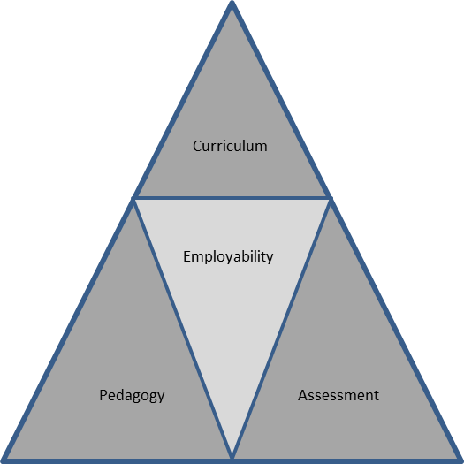
Figure 1: The Curriculum, Pedagogy, Assessment and Employability Relationship

Slide 16
Curriculum & Employability (cont’d)
A coherent curriculum aligns all learning, teaching and assessment activities to its objectives.
For example, UB has 12 Graduate attributes: Information and communication literacy, Self-directed, life-long learning orientation, Critical and creative thinking, Problem-solving, Effective written and verbal communication; Entrepreneurship and employability; Organisation and teamwork;

Slide 17
Curriculum & Employability (cont’d)
Research skills and information literacy; Social responsibility and leadership; Interpersonal skills; Cross-cultural fluency; Accountability
These attributes may not be developed through ‘passive’ learning and/or summative assessment approaches.
All courses in a coherent curriculum must embed key employability skills in learning, teaching and assessment activities.

Slide 18
Implications
Curriculum Development, Teaching and Learning Activities and Assessment Regimes must be treated as inextricably intertwined elements. (Is separating BEC and Curriculum Development a wise idea in view of the needs of constructive alignment? What’s the situation in universities?)
Such thinking demands that staff be trained in ‘curriculum development’.
There is a need for academic development units in institutions (e.g CAD)
A teaching qualification at tertiary level should be required.

