Slide 1

Welcome

Slide 2

T. CHIKEREMA
LEARNING STYLES
FACULTY OF EDUCATION

Slide 3
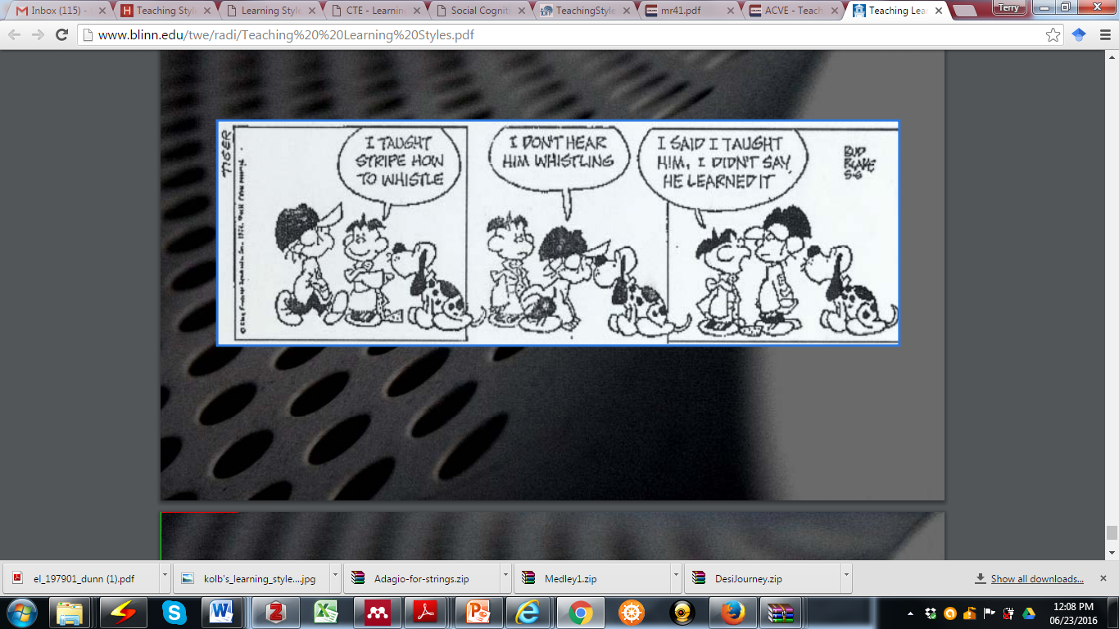
What do you perceive?

Slide 4
Do you know how you and/or your learners learn?
Are you aware of your own learning style?
If you do not know, how do you expect to know your students’ ?
If you know yours, have you ever bothered to know your students’?
If you know yours and your students’, to what extent does your teaching style suit your students’ learning styles?

Slide 5
Outline
What are learning styles?
Teaching Styles vs Learning Styles
  Where do we draw the line?
  Can they be matched?
How do I get to know about my learning and teaching styles?
Do learning styles exist?

Slide 6
Definition
provide insight into how learners perceive, interact with and respond to the environment in which learning occurs (Brown,2003)
“the manner in which individuals choose to or are inclined to approach a learning situation” (Cassidy, 2010, p 420).
describes individual differences in learning based on the learner's preference for employing different phases of the learning cycle ( Kolb and Kolb, 2005)
The preferred way of perceiving and processing , comprehends new information and retains it

Slide 7
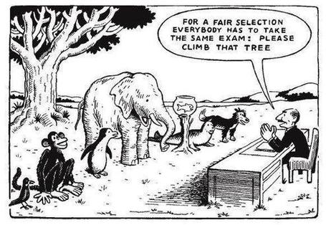
Is this familiar???????
?
?
?
?

Slide 8
Activity
You have 1 min to remember this number
131981676765432

Slide 9

Classifications: Sensory learning Style ( Neil Fleming’s)

Slide 10
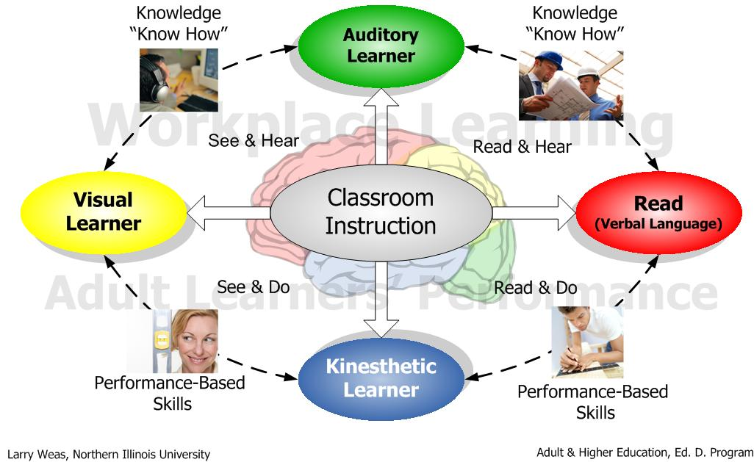
Classification: Sensory ( VARK/VAKT/VATK)
Source: Weas, L.D (n.d)

Slide 11
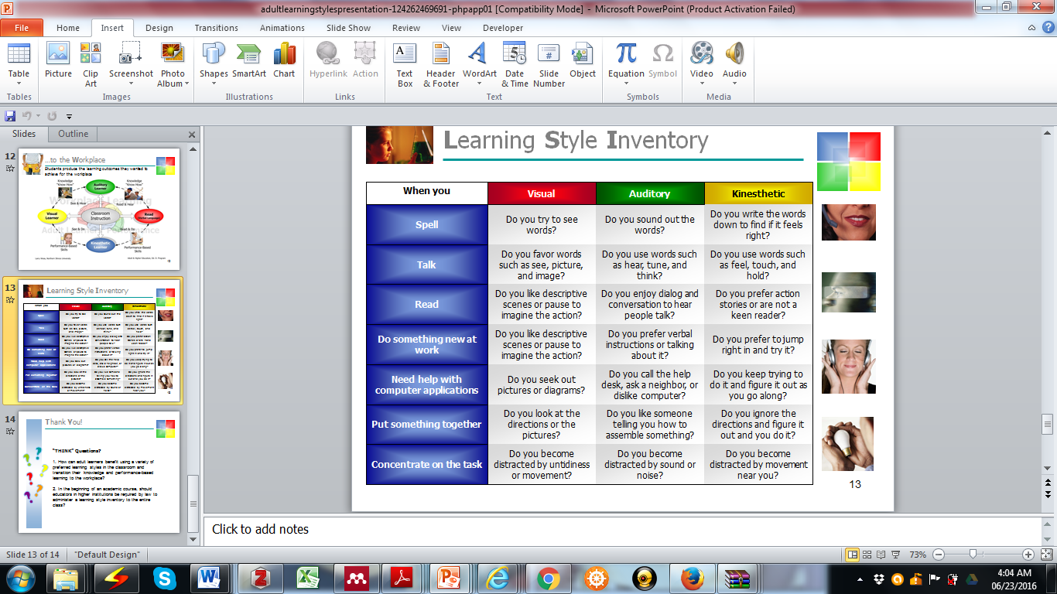
VARK Inventory Styles

Slide 12
VARK questionnaire
You can check you learning styles through the VARK questionnaire accessible at:
http://vark-learn.com/the-vark-questionnaire/

Slide 13
Classification: Learning Approach
Deep Learning
-have the intention to seek meaning, and engaging with the content, create a personal understanding of the subject (Marchese, 1997)
Surface learning-
Surface learners only learn what is necessary for their survival
You might have heard this expression “ Is it part of the exam?”

Slide 14
Classification: Learning Approach
Cont…
Strategic learning
Intend to obtain high grades
Organise their time and distribute their effort to greatest effect
NB Strategic learners engage with the content and succeed

Slide 15
Definition
Teaching behaviors that reflect the beliefs and values that teachers hold about the learners’ role in the exchange (Heimlich and Norland 2002)

Slide 16
Classification: Kolb’s learning Styles
- Underpinning Theory is the Experiential Learning Theory (ELT)
-ELT defines learning as "the process whereby knowledge is created through the transformation of experience. Knowledge results from the combination of grasping and transforming experience" (Kolb, 1984: 41)

Slide 17
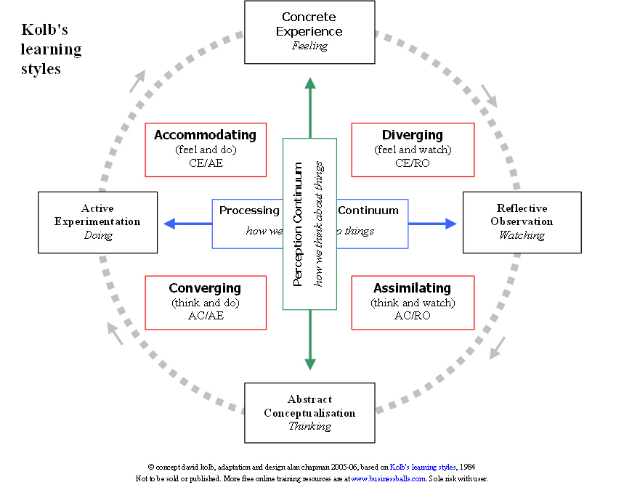
Classification: Kolb’s Learning styles

Slide 18
Classification: Kolb’s Learning styles
-Immediate or concrete experiences provide a basis for observation and reflections ( Divergers)
Reflective observation gives basis for conceptualization and abstractions (Assimilators)
Abstract conceptualisation gives basis for active experimentation ( Convergers)
Active experimentation gives basis for trial and error making the student re-live the process once again
http://www.clinteach.com.au/assets/LEARNING-STYLES-Kolb-QUESTIONNAIRE.pdf

Slide 19
Classification: Kolb’s Learning styles
Activity
With reference to Kolb’s learning Styles, what is the role of the faculties in each of the 4 quadrants?

Slide 20
Teaching styles
According to the Grasha –Riechmann teaching style survey, the teaching styles are :
    Expert
    Formal authority
    Personal Model
    Facilitator
    Delegator
For the Teaching Style Inventory (TSI)
  http://longleaf.net/teachingstyle.html

Slide 21

What does research say on learning styles?

Slide 22
Q & A session

Slide 23
Takeaways
Vary your teaching styles to cater for a diverse student body
Reflect on your teaching practices
  Teaching is both reflective and reflexive
  Learning Styles, achievement, abilities ?????? Food for thought

Slide 24
THANK YOU

Slide 25
References
Brown, L.D., Teaching Styles vs learning Styles : Myths and realities,26, ERIC
Cassidy, S. (2010). Learning Styles: An overview of theories, models, and measures. Educational Psychology: An International Journal of Experimental Educational Psychology, 24:4, 419-444, DOI: 10.1080/0144341042000228834
Kolb, Alice Y. and Kolb, David A. (2005) , Learning Styles and Learning Spaces: Enhancing Experiential Learning in Higher Education, Academy of Management Learning & Education, Vol. 4, No. 2, pp. 193-212
Marchese, T. J. (1997). The new conversations about learning. In B. Cambridge (Ed.), Assessing impact: Evidence and action (pp. 79-95). Washington, DC: American Association for Higher Education.

