Slide 1

Welcome

Slide 2
  LECTURE PREPARATION
  “BEING A TOGETHER LECTURER”
  BY
  WILLIAM NKOMO
  TEAM LEADER - SOFTWARE ENGINEERING AND PROFESSIONAL PRACTICE
  (FRANCISTOWN)

Slide 3
Has it ever crossed your mind??
What makes lecturer X better than lecturer Y in getting their work done?
What makes you fail to cover the content within the 1 hour or 2 ½ hours period?
Why? Why?

Slide 4
What we know about a “good Lecture”
A good lecture encompasses a range of teaching/learning styles, approaches and formats and must have objectives that:
    Motivate and challenge learners,
    Give students insights,
    Focus on students’ learning.
Dr. Mihram, D., 2013. Delivering Powerful Lectures. California, University of Southern California.

Slide 5
As lecturers we must always aim at getting the teaching/learning locomotive well-greased if we want to always come out of our lectures smiling.
We therefore have the following agenda for this presentation today;

Slide 6
Agenda
What is being “together”
Levels of togetherness
Getting to be “together”
How to give a killer opener
do and don’ts for the “togethers”
Summing it up
Audience’s views

Slide 7
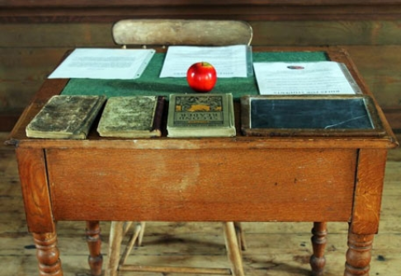
WHAT IS BEING “TOGETHER”?

Slide 8
Together lecturers demonstrate five essential skills:

Slide 9
1. Prioritization
  They focus on the right things at any given time.
  A lecturer who does not prioritize may wonder about entertaining students and fail to get the teaching/learning off the ground.

Slide 10
2. Planning
Ability to consistently look ahead and determine how to get there – writing the steps on how to get things done.
Using a calendar, weekly worksheet, Google Keep e.t.c.

Slide 11
3. Organisation
An organised lecturer have clear processes and systems to do things in the classroom.
For example, a system for collecting and handing back students’ assignments (turnitin, blackboard e.t.c), storage of equipment, and so on.

Slide 12
Signs of disorganisation: desk buried in papers, car boot full of students’ assignments you meant to return some few days ago

Slide 13
4. Execution
He/she works with intentionality.
Takes note of how long each task will take to finish.
Enjoys getting things done.

Slide 14
5. Efficiency
Efficient lecturers take little bits of their time and maximise it to the fullest.
Basically as lecturers we need to develop habits in all the 5 areas in order to be “together” .

Slide 15
Levels of togetherness
To be together may mean different things to different individuals. For example:
  Lecturer 1:
  “…Having a neat filing system that allow you to easily locate all your teaching materials for your lesson…”

Slide 16
Lecturer 2:
  “…When I always meet deadlines for lesson plans or using time effectively to get more done in few minutes…”

Slide 17
Lecturer 3:
  “…Having a perfect plan for a field trip. Managing my home and school chores…”

Slide 18
Levels of togetherness
Maia proposed 4 levels of togetherness that each lecturer can fall into.
Heyck-Merlin, M., 2012. The Together Teacher: Plan Ahead, Get Organized, and Save Time!. 1st ed. San Francisco: John Wiley & Sons.

Slide 19
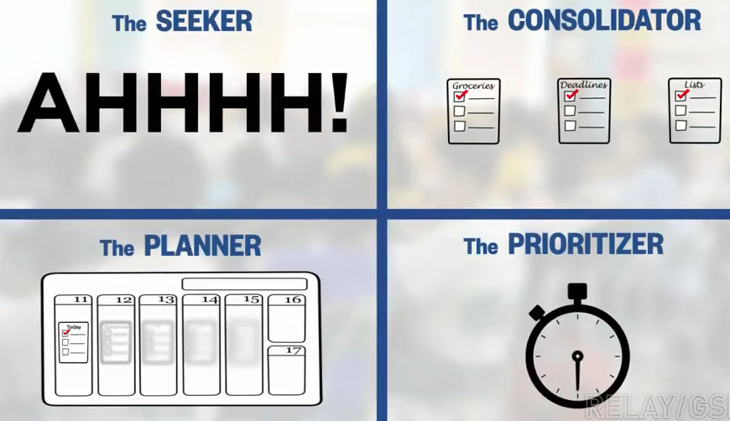

Slide 20
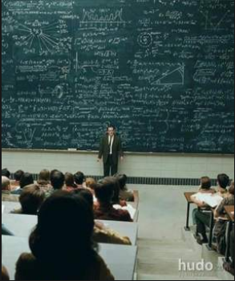
Consolidator
I have one to-do list on my smart phone, and another five on my diary. I also have lots of notes that I e-mail to myself.
I want to combine all of them into one list.

Slide 21
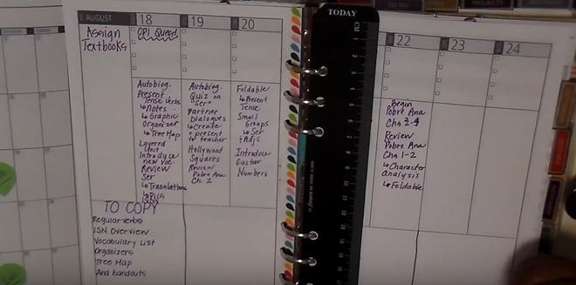
Planner
I want to get all my work, holiday plans and any other things to be done well on time. I do not want to be taken by surprise or do things in a rush.

Slide 22
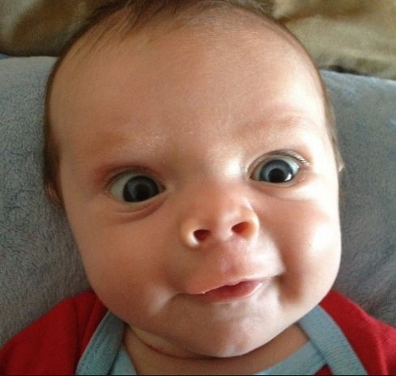
Seeker
I have so much going on that I don’t even know where all my to-dos are. AAAHHHH!!!

Slide 23
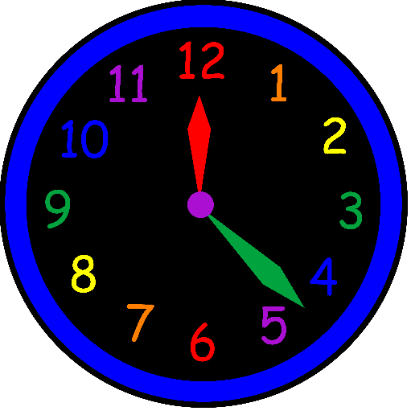
Prioritizer
When I have 35 extra minutes, I do the easy stuff. I want to do a better job handling the most important work. For example, using preparation period to grade your students’ internal marks, check your batch file, and so on.

Slide 24
Getting to be “together”
Maia’s video

Slide 25
A together lecturer has unique ways of starting a presentation
Give a confident introduction
Give your credentials
Deliver your hook
Introduce your agenda
Give a credible statement

Slide 26
How to start a presentation
Video

Slide 27
What teaching aids must you have in place
Relevant EduTech
board wiper, marker
Your Milestone
Handouts for learners
Summarised content
A bottle of water

Slide 28
What to do and what not to do in a lecture room
Dos and don’ts in front of learners

Slide 29
Summing it up
A together lecturer, irrespective of his/her togetherness level:
  Plans on time and gathers all necessary lecturing materials for the session,
  Prepares the classroom – even the seating formation for that session
  Rehearses

Slide 30
  Knows his/her learners’ preferences
  looks presentable
  Seeks other peoples’ opinions about the quality of his/her presentation

Slide 31
Thank you !

