Slide 1


Slide 2
WHAT INFORMS YOUR TEACHING?
Silas Oluka

Slide 3
A Journey
Invitation
Where are we coming from ?
Where are we now?
Where do we want to go?

Slide 4
Invitation
You are a farmer
You are a professor

Slide 5
Where we have come from

Slide 6
Africa Condition
Worldwide Education is advocated as prerequisite for modernization and economic development
The challenge: Has it delivered on these claims of development and modernisation?

Slide 7
Education in Africa: What we witness
The impact: useful; but also disappointing
There is less inquiry learning, more rote learning
Students are less, rather than more, able to extract meaning from their schooling for relevant application
The “educated” are a contradiction

Slide 8
Higher Education Challenge
Access is not enough!
Good Teaching is not enough!
Good Intentions are not enough!
Economy and world of work demand greater efficiency & accountability.

Slide 9
Labor & Skills Gaps
Labor Force Trends
Greatest worker shortage in Africa’s history will return.
40-60% of jobs in 2020 don’t exist today.
70% of recent high school graduates require remediation.
Opportunity for School dropouts.
Jobs of the future require higher skills & knowledge.

Slide 10
Where are we now?

Slide 11
What type of Graduate?
Workplace landscape
Curriculum
Pedagogy
“The time for fundamental change is when society’s needs can no longer be met by the institutions that serve it.” -Al Lorenzo

Slide 12
Change is at Hand
Economy
Globalization
Technology
Changing Demographics
Curriculum & delivery must have a variety of options
Students must get engaged.
Pre and post assessments – (We must measure what learning occurs)

Slide 13

Five Minds for the Future
Synthesizing
arraying information to make sense to self and others
Disciplined
mastery of key subjects
Respectful
seeking to understand differences
Ethical
striving toward good work and good citizenship
Creating
beyond existing knowledge and syntheses to pose new questions
Gardner, Howard. (2007). Five minds for the future. Boston: Harvard Business School Press.

Slide 14
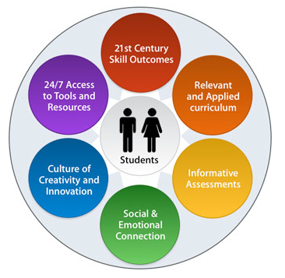

Slide 15
Higher Education Challenge
Students must leave colleges with a core set of workplace skills:
Students must leave colleges with a core set of workplace skills:
12. Experience: work, internships,
11. Academic & Technical Skills
10. Be Active Learners
9. Be Forward Thinking
8. Be Organized
7. Be Results Oriented
6. Be Service Oriented
5. Be a Problem Solver
4. Be a Team Player
3. Strong Work Ethic
2. Good Communicator
Positive Attitude!
12 Laws for Becoming Indispensable - Zeiss

Slide 16
Higher Education Challenge: The Shift
Consuming |  | Producing
Authority |  | Transparency
Expert |  | Facilitator
Access to Information |  | Access to People
Passive |  | Passionate
Presentation |  | Participation
Formal Schooling |  | Lifelong Learning
http://www.stevehargadon.com/2008/03/web-20-is-future-of-education.html

Slide 17

Core Learner Competencies
Communication
Critical Thinking
Personal Growth & Responsibility
Information Technology~

Slide 18
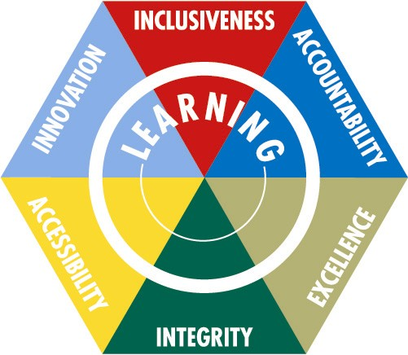
Aligning University Values to Support Learning

Slide 19
Today’s universities are struggling to move from “Teaching & Teachers” to “Learning & Learners”.
Universities exist to provide added value to students & their communities. We must measure that value via learning outcomes.
Nothing affects our future like our ability to educate!

Slide 20
What are possible directions for Higher Education?
What do these demand of my teaching?

Slide 21
Outcome-based education
Bologna Process: focus on learning outcomes (student centered view)
Learning outcomes state what a learner
  knows, understands
  (knowledge), and
  is able to do
  (skills, competences)
after completing a learning process.
Teaching methods
Learning outcomes
Workload
Assessment techniques

Slide 22
Learning Outcomes
Learning Outcomes
Competence (Personal and Professional)
Skill
Ability to apply knowledge and use know-how to complete tasks and solve problems
Personal, social and or methodological abilities
Knowledge
Outcome of assimilation of information through learning

Slide 23
Intended vs Achieved Outcomes
The teacher defines intended learning outcomes for a learning opportunity
The teacher assesses and learners demonstrate the achievement of intended learning outcomes

Slide 24
Where do we want to go?
Notes:
Consuming
Producing
Authority
Transparency
Expert
Facilitator
Access to Information
Access to People
Passive
Passionate
Presentation
Participation
Formal Schooling
Lifelong Learning

Slide 25
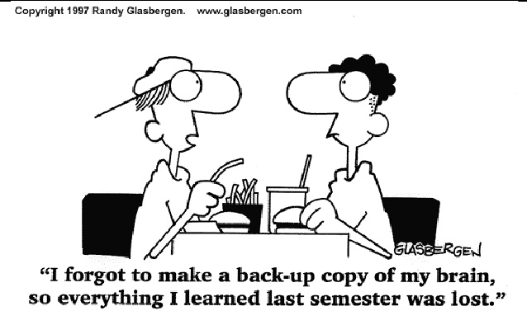

Slide 26
The whole art of teaching is only the art of awakening the natural curiosity of young minds for the purpose of satisfying it afterwards.
Anatole France

Slide 27
Teaching methods
Learning outcomes
Workload
Assessment techniques

Slide 28
Sequential
Intuitive
Active
Visual
Deductive
Inductive
Verbal
Sensory
Reflective
Global

Slide 29
What do I want for my students?

Slide 30
A little girl’s story

Slide 31
What do we want for our students?
‘We all want students who have high expectations of themselves as learners; students who feel confident about their capacity to learn, who set high goals for their learning, and who work for themselves to construct enjoyable, challenging learning pathways to their futures’
(Absolum, 2006)

Slide 32
The word ‘assess’
Comes from the Latin verb ‘assidere’ meaning ‘to sit with’. In assessment, one should sit with the learner.
This implies it is something we do with and for students and not to students (Green, 1998)

Slide 33
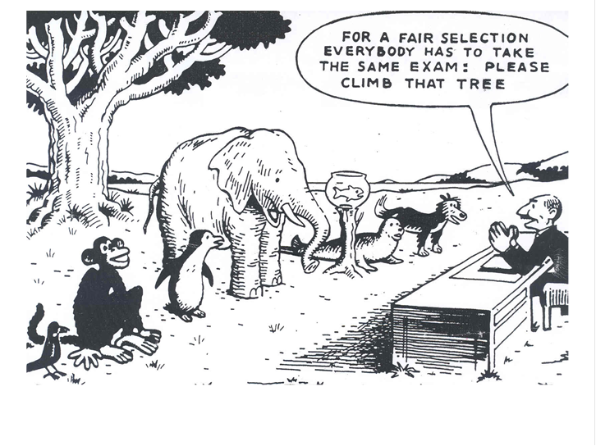

Slide 34
Teaching methods
Learning outcomes
Workload
Assessment techniques

Slide 35
The Future…
Dealing with complexities of teaching
Earning trust

Slide 36

The Future: Scale of Familiarity

Slide 37
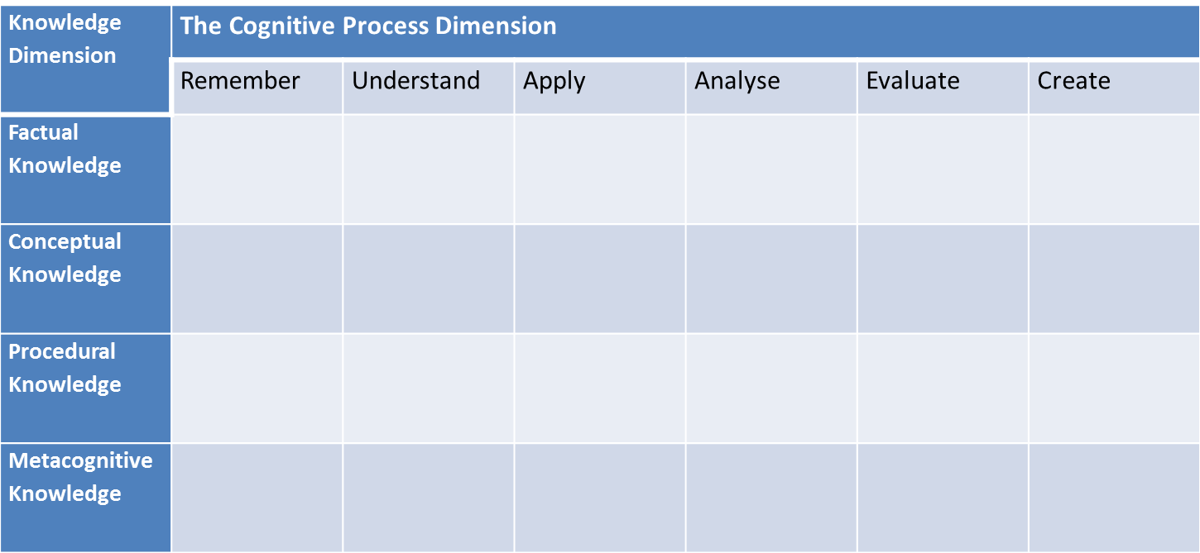

Slide 38
Conclusion
How do you demonstrate that your teaching strategies are in fact causing learning?

Slide 39
What informs your Teaching?

Slide 40
THANK YOU!

