Slide 1
Cyber Security Trends and Opportunities
Ajay Nagarajan
Senior Consultant,
Risk Management & Security Investigations

Slide 2
Agenda
Recent cybersecurity trends
  Motivate need for cyber risk management
  Motivate need for cybersecurity skills
Overview of Advanced Persistent Threats (APT)
  Beyond the regular malware
Reaching Security Maturity
  NIST Frameworks that help address concerns
Opportunities
  Cyber skills shortage
Industry Cyber Security offerings
Addressing Skills Shortage

Slide 3
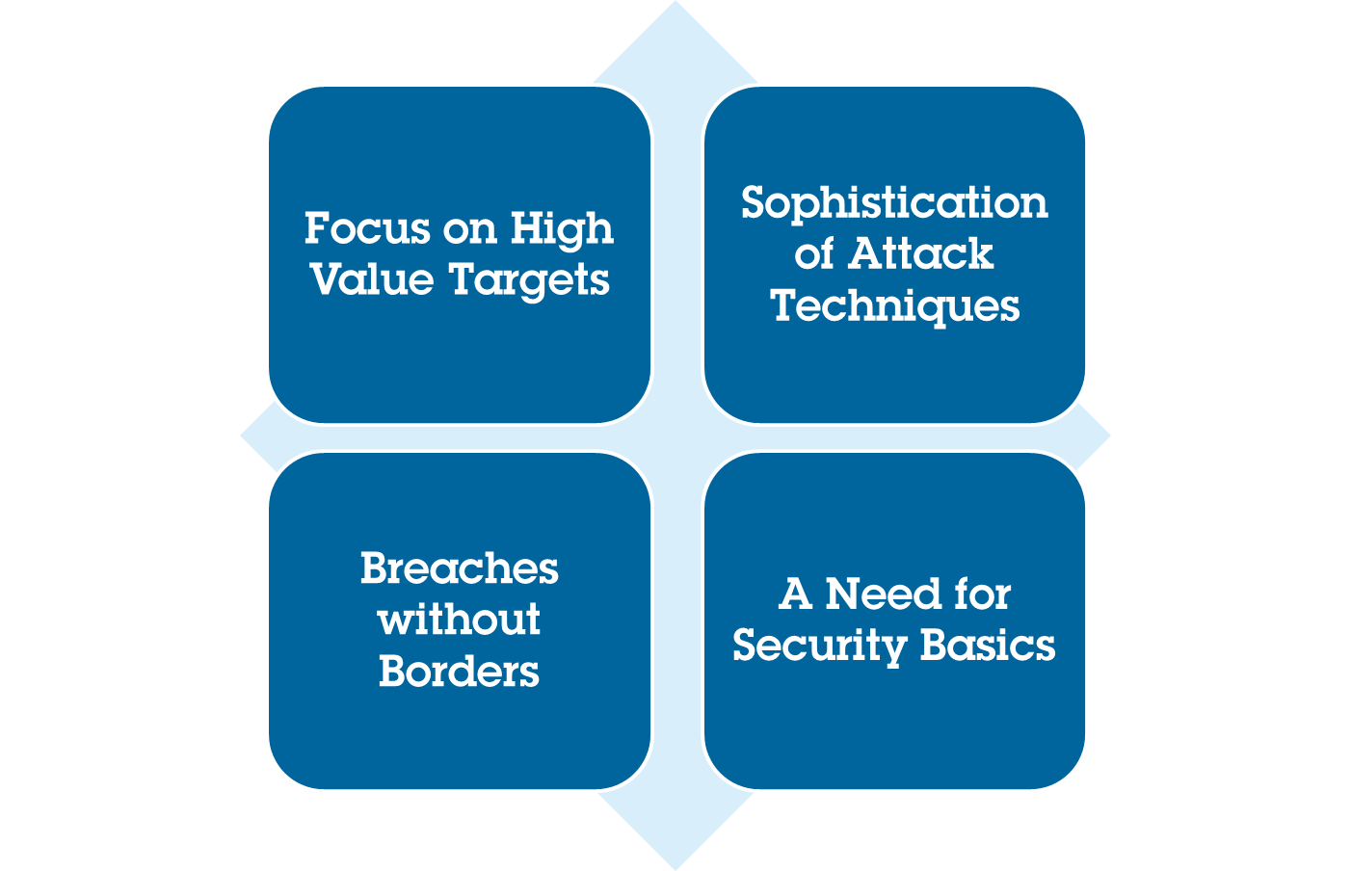
Key Trends from 2015
Notes:
Focus on High Value Targets: Health-related PII and other highly sensitive data can be used for social engineering to access even more valuable financial targets
Sophistication of Attack Techniques: Quantum leaps in mobile malware juxtapose a continued use of classics like DDoS and POS malware
Breaches without Borders: Breaches are now being reported more widely around the world due to expanded targeting and stricter disclosure guidelines
A Need for Security Basics: Many of the incidents we’ve seen could be avoided with a focus on security basics

Slide 4
Key Trends and Drivers of Security
Consumerization
Mobile devices
Social media
Cloud services
Nonstandard
Security as a Service
Emerging Trends
Decrease in time to exploit
Targeted attacks
Advanced persistent threats (APTs)
Continual Regulatory and Compliance Pressures
SOX, PCI, EU Privacy
ISO 27001
Other regulations

Slide 5
Security Sector Highlights
Cloud and Virtualization Trends
  Volume of Data has exploded
  Monitoring Virtual Machines / Cloud
  BYOX Endpoints and access points have increased
  Consumerization of IT creates headaches for CISOs
Visibility on security
Technological Complexity
Large number of tools / vendors
Quality of tools is just about “Good Enough”
Shift towards Managed Security Service Providers (MSSPs)
Potential acquirers face structural challenges
Fragmented market
Financial drivers
Political motivations – theft of IP
Reputational damage
Sophisticated adversaries
  Minimal investment can create significant damage
Systematic efforts – Target and Home Depot used the same payload
Motivated adversaries
Notes:
Key takeaway:

Slide 6
Evolution of cybersecurity
 | Then
Security | Perimeter based
Applications | On Premise
Threats | Static
Types of adversaries | Technical chops
Frequency of attacks | ??
Security Assessment | Periodic
Cyber-security Products | Good enough
Now
Data based
SaaS / Cloud
Dynamic
Financially / Political motivated
200 / minute
Real Time / Continuous
Precision, Relevance & Speed
Impact / Opportunities
Mobile /Encryption/ Key Management
Security-as-a-service
Event Management / Incident Response
Regulation
Monitoring tools
Vulnerability / Pen Testing
Contextual relevance

Slide 7
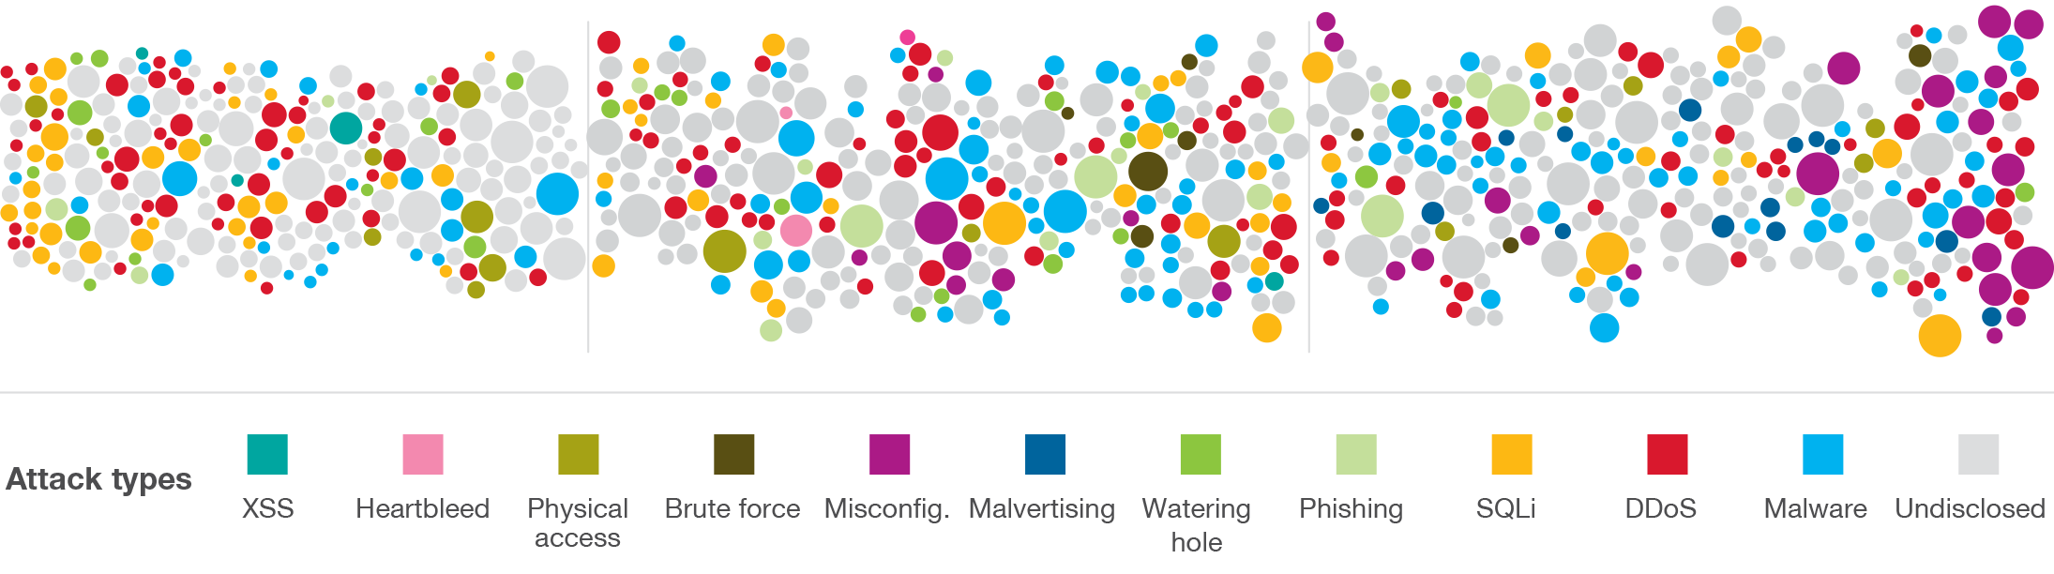
Attacks are focusing on higher value data targets
2013
800,000,000+ records
breached, with no signs of decreasing in the future
2014
1,000,000,000 records
breached, while CISOs cite increasing risks from external threats
2015
Healthcare mega-breaches
set the trend for high value targets of sensitive information
Source: IBM X-Force Threat Intelligence Report - 2016
Notes:
By January 2016, IBM® X-Force® had tracked 272 security incidents for 2015, on par with the 279 incidents tracked in 2014. In terms of total disclosed records, 2014 was notable for more than one billion records being leaked, while 2015 was down to a still staggering 600 million leaked records in incidents tracked by X-Force using public breach disclosures.
Notes on 2015:
Cybercriminals’ targets are now bigger and their rewards greater as they fine-tune efforts to obtain and leverage higher value data than years past.
The demand for leaked data is trending toward higher-value records such as health-related personally identifiable information (PII) and other highly sensitive data, with less emphasis on the emails, passwords and even credit card data that were the targets of years past. This PII can be used for social engineering to gain access to valuable financial targets.
February saw the first of five 2015 healthcare mega-breach disclosures, which together exposed nearly 100 million records of patient data. While stolen credit card data and user account information can be valuable, these records have a short lifespan and are replaceable. In contrast, Social Security numbers and health history data stolen in these incidents are both much more sensitive and personal to the victims, as well as much harder to replace. As reported by the recent IBM/ Ponemon data breach study, dark web resale of healthcare data can be worth as much as USD363 per record compared to the average for all types of data of USD154
In addition to the theft of healthcare data, 2015 saw an increase in the trading of another type of highly sensitive information. Breaches at adult websites including Adult Friend Finder and Ashley Madison exposed people’s sexual preferences and infidelities to the general public. The intimate nature of this data opened opportunities for extortion and increased social engineering intelligence. It also was linked to a number of suicides of affected victims. More than ever, these incidents bring attention to the complex intersection between our digital and physical identities.

Slide 8
Highly regulated industries have the highest per-record data breach costs
$359
$294
$227
$206
Healthcare
Education
Pharmaceutical
Financial
$155
$141
$122
$105
Consumer
Energy
Hospitality
Retail
*Currencies converted to US dollars
Source: 2014 Cost of Data Breach Study: Global Analysis, Ponemon Institute, sponsored by IBM
Notes:
Heavily regulated industries such as healthcare, education, pharmaceutical and financial services had a per capita data breach cost substantially above the overall mean of $145. Public sector organizations and retail companies had a per capita cost well below the overall mean value.

Slide 9
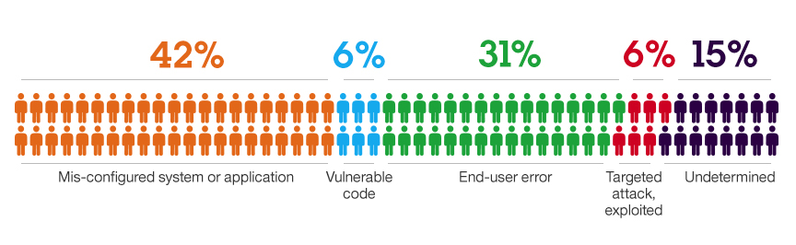
Why do Breaches Happen?
Vulnerabilities
Malware
Configuration Errors
“Weak” defaults
Easy passwords
Installing suspect applications
Clicking malicious links
“Bugs”
Input validation
Phishing Emails
Watering Hole attacks
Source: IBM Security Services 2013 Cyber Security Intelligence Index

Slide 10
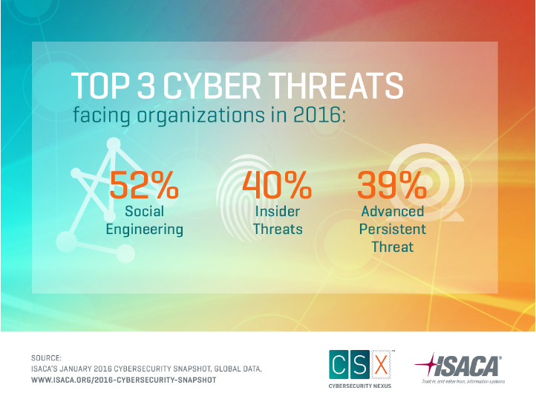

Slide 11
The rise of crimeware
Source: Verizon DBIR 2015

Slide 12
Phishing in the sea
Source: Verizon DBIR 2015

Slide 13
No sector left behind

Slide 14
The World is Changing
Advanced Persistent Threat
ADVANCED, STEALTHY, AND CHAMELEON-LIKE in its adaptability
Once thought to be limited to attacks on government networks
However, commonplace and can happen to any enterprise
Primary purpose of majority is to extract information from systems
  Critical research
  Intellectual property
  Government information
  Among other things

Slide 15
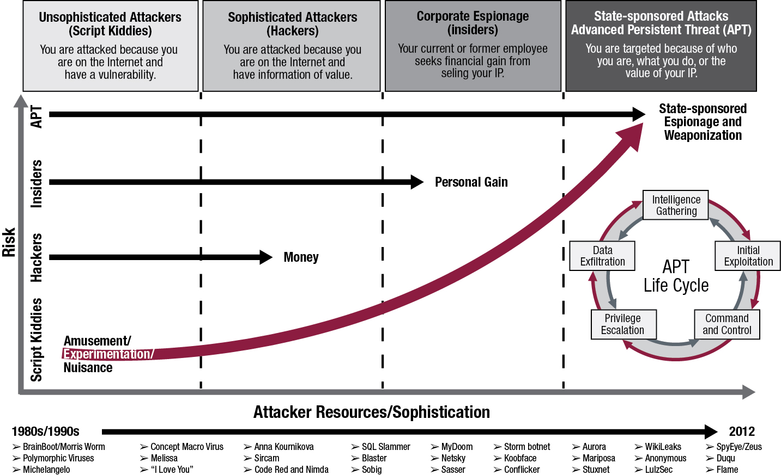
The World is Changing

Slide 16
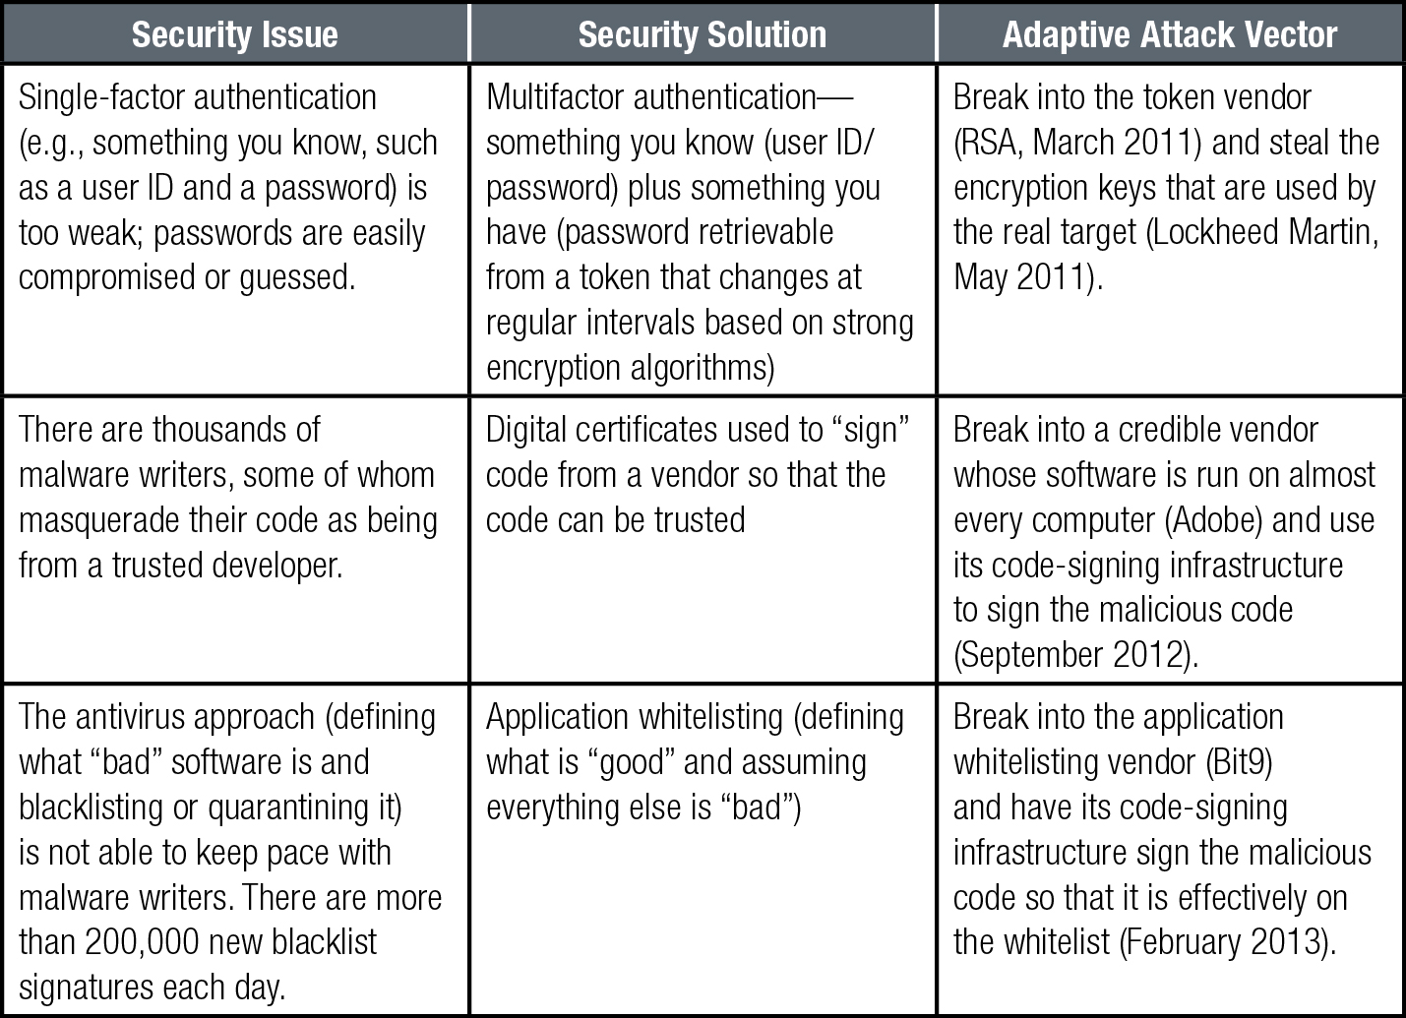
Adaptive Attack Vectors
The threat landscape will continue to evolve as attackers adapt new and innovative attack methods to existing or adaptive attack vectors while defenders deploy new defense strategies.

Slide 17
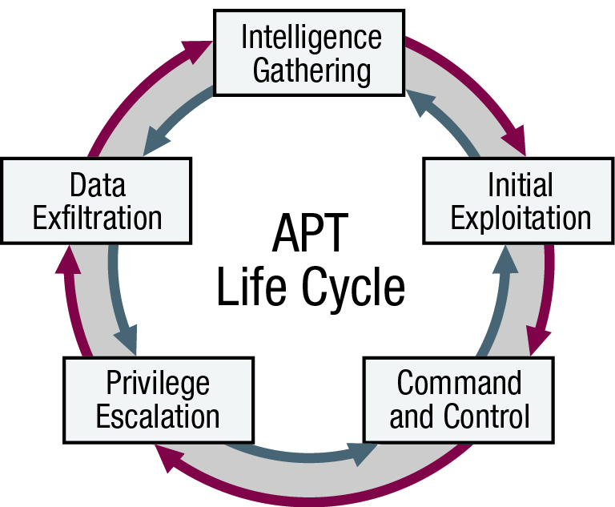
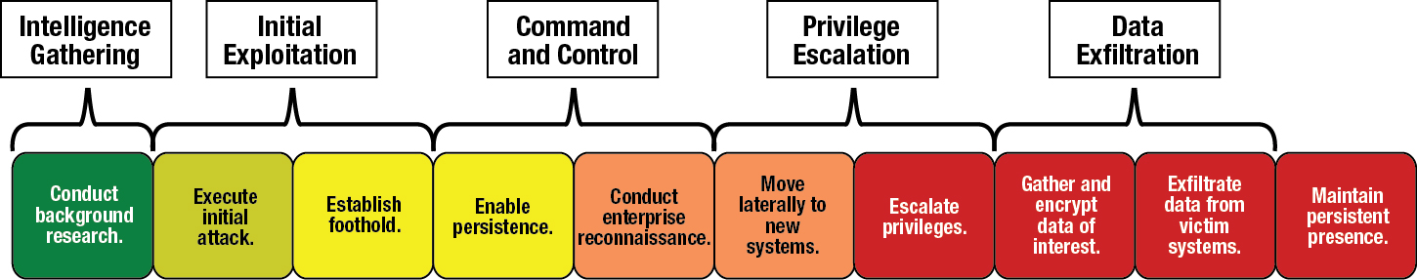
The APT Life Cycle
History shows that most sophisticated attackers, regardless of their motives, funding or control, tend to operate in a certain cycle and are extremely effective at attacking their targets.

Slide 18
APT Modus Operandi
APTs have adapted their tactics, techniques and procedures to the typical information security architecture they find deployed. For example…
Traditional Security Practice | APT’s Modus Operandi
Network boundary/perimeter devices inspect traffic content. | SSL, custom encryption, and password protected/encrypted container files make packet content inspection difficult or impossible.
Network firewalls monitor and assess traffic metadata. | Communication initiated from within the network using standard ports and protocols (HTTP, DNS, SSL, SMTP, etc.).
Host firewalls monitor and assess local traffic metadata. | Initial infection tool adds malware to host firewall white list.
Intrusion detection and prevention systems with real-time assessment and alerting running on servers and workstations. | Communications use common ports and protocols – hide in plain site within obvious/allowed traffic.

Slide 19
The 2014 U.S. State of Cybercrime Survey
The survey identified eight common deficiencies where spending and efforts lag:
  Most organizations do not take a strategic approach to cybersecurity spending
  Organizations do not assess security capabilities of third-party providers
  Supply chain risks are not understood or adequately assessed
  Security for mobile devices is inadequate and has elevated risks
  Cyber risks are not sufficiently assessed
  Organizations do not collaborate to share intelligence on threats and responses
  Insider threats are not sufficiently addressed
  Employee training and awareness is very effective at deterring and responding to incidents, yet it is lacking at most organizations
http://www.pwc.com/us/en/increasing-it-effectiveness/publications/2014-us-state-of-cybercrime.jhtml
Co-sponsored by CSO magazine, CERT Division of the Software Engineering Institute at Carnegie Mellon University, PwC,
and the US Secret Service, March-April 2014

Slide 20
Security frameworks and risk-management strategies address
Evolving threats | Including the growing sophistication of threats, new attack methods, and adaptations to technologies or delivery methods
Changing business needs | Including evolving lines of business, acquisitions, mergers, the integration of operations, and the addition or elimination of business functions
Volatile economics | Including changes in business profitability, the market for the organization’s goods or services, national and international economic trends, or wholesale currency changes
Increasing regulation | Including changes and additions to regulation and compliance requirements, locally, nationally or internationally
Technology and process changes | Including adding new or removing existing technologies, or implementing a bring-your-own-device (BYOD) program
Geographic and facilities changes | Including moving to a new location or having data-center or cloud services added from another area

Slide 21
Reaching security maturity – how to map your way there
 | Security Intelligence
 | Predictive Analytics, Big Data Workbench, Flow Analytics
 | SIEM and Vulnerability Management
 | Log Management
 | Advanced Fraud Protection
 | People | Data | Applications | Infrastructure
 | Identity governance Fine-grained entitlements Privileged user management | Data governance Encryption key management | Fraud detection Hybrid scanning and correlation | Multi-faceted network protection Anomaly detection Hardened
 | User provisioning Access management Strong authentication | Data masking / redaction Database activity monitoring Data loss prevention | Web application protection Source code scanning | Virtualization security Asset management Endpoint / network security management
 | Directory management | Encryption Database access control | Application scanning | Perimeter security Host security Anti-virus
Optimized
Proficient
Basic
13-09-17

Slide 22
NIST (National Institute of Standards and Technology) Handy Resources
1. NIST Special Publication 800-53 “Security and Privacy Controls for Federal Information Systems and Organizations”
2. NIST Cybersecurity Framework “Framework for improving critical infrastructure cybersecurity”

Slide 23
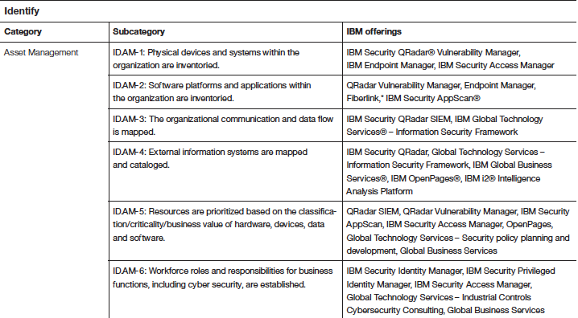
Map your Security to the NIST Framework

Slide 24
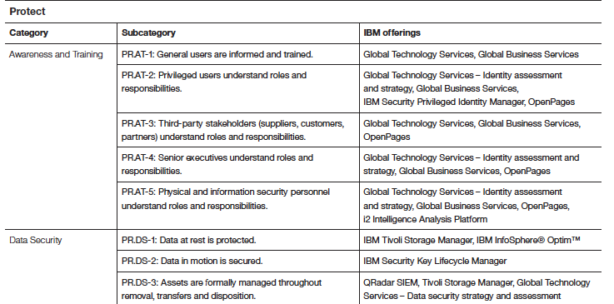
Map your Security to the NIST Framework

Slide 25








CISOs face a shortage of skills, lack of metrics and strategy
Security Maturity
Board of Directors
Stakeholders
Compliance Mandates
Industry Standards
49%
31%
83%
of IT executives have no measure
of security effectiveness
2012 Forrester Research Study
of IT professionals
have no risk strategy
2013 Global Reputational Risk & IT Study, IBM
of enterprises have difficulty finding
the security skills they need
2012 ESG Research

Slide 26
Cybersecurity: Market need
Cybersecurity is a top global concern. 82% of enterprises expect to experience a cyber incident in 2015
More than 35% are unable to fill open cybersecurity positions
69% say certification is required for cybersecurity jobs
33% say qualified candidates have hands-on experience
46% say technical skills are needed
There is a cybersecurity skills crisis: 1 million unfilled jobs (source: Cisco)
The research is clear. Cybersecurity has evolved from critical topic into a public safety issue

Slide 27
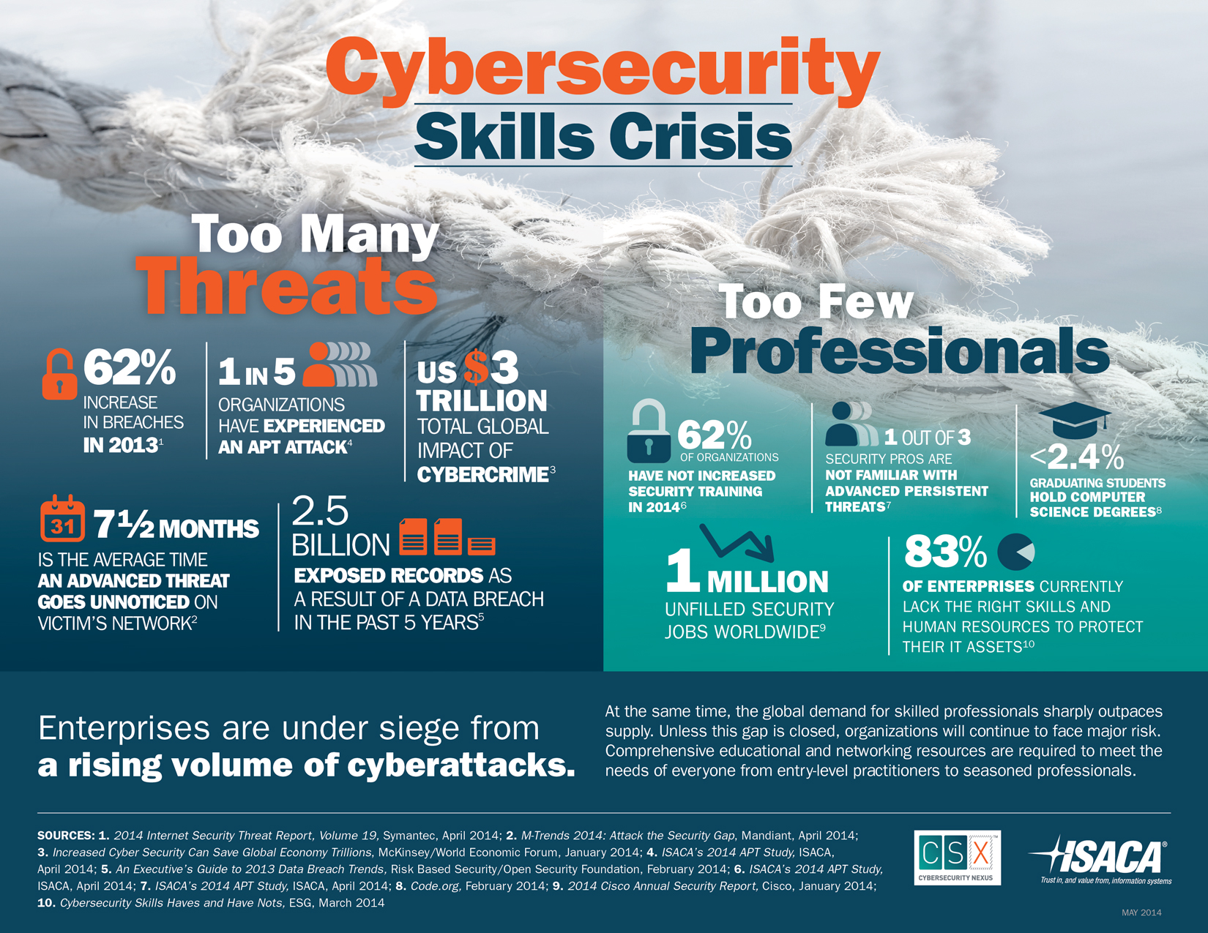

Slide 28
Industry Cyber Security Service Offerings
Can largely be bucketed under 3 umbrellas:
Security Science
  Proactive Risk Assessments
    Vulnerability Assessments
    Ethical Hacking
    Network Security Review
    Cloud Security Review
    Application Security Review
Incident Response
  Investigate on-going incident
    Log Reviews and Correlation
    Looking for indicators of compromise
    Stop the bleeding
Digital Forensics
  Post-incident Analysis
    Computer Forensics
    Network Forensics
    Mobile Forensics

Slide 29
Addressing Skills Shortage
Technical Skills that the Industry is looking for:
Security Science related skills
  Strong Information Security fundamentals – theoretical knowledge – coursework
  Strong network fundamentals – course work / certification
    Labs and Hands-on experience important
    Open-source options: GNS 3.0 suite
  Vulnerability Assessment / Penetration Testing Skills
    Labs and Hands-on experience important
    Open-source options: KALI Linux suite, Burpsuite
  Cloud Security
    Familiarity with Amazon Web Services offerings (at a minimum)
    MS Azure a plus
  Application Security
    Familiarity with OWASP Top 10
    Familiarity with Static and Dynamic scanning tools
    Open-source option: ZAP, BurpSuite, W3af, skipfish, KALI Linux suite

Slide 30
Addressing Skills Shortage
Technical Skills that the Industry is looking for:
Digital Forensics related skills
  Critical thinking / analytical skills
  Strong understanding of file system / registry
  Industry standard tool: EnCase
  Open-source option: X-Ways, XXCopy
  Lab / Hands-on experience important
    Imaging devices and hard drives to keep it forensically sound
    Special hardware required (e.g. Image master)
  Mobile Forensics
    Industry standard tool: Cellebrite
    Lab environment: Faraday cage

Slide 31
Addressing Skills Shortage
Technical Skills that the Industry is looking for:
Incident Response related skills
  Critical thinking / analytical skills
  Ability to work under stress / at odd times during the day
  Sufficient familiarity with Python / JSON
  Ability to read different types of logs
  Familiarity with SIEM Tools
    Important Open-source tool: Splunk
  A good understanding of common Indicators of Compromise

Slide 32
Most Important Skill: Staying Informed
Cyber Security is an ever-changing field. What was relevant yesterday is no longer relevant today. It is important to stay on top of current happenings in Cyber:
Some useful resources:
  Slashdot.org
  Krebs on Security
  Bruce Schneier on Security
  ThreatPost

Slide 33
Questions / Thoughts / Comments ?
Thanks !!
E-mail: ajay.nagarajan@gmail.com

