Slide 1
Learning in a digital age: A case study on the effective use of e-Fundi in the North West University
Dr Mmaki Jantjies
Department of Information System
Faculty of ECONOMIC AND MANAGEMENT SCIENCE
UNIVERSITY OF WESTERN CAPE- Belville/ Cape Town South Africa

Slide 2
Session
Part 1 –Case Study
Part 2 –How do you “blend the learning”

Slide 3

University of Warwick
University of North West
University of Cape Town
University of Western Cape
Consultancy
NGO ICT4 Dev
Women in ICT Forum
Association of M/learn

Slide 4
Research areas
ICT4Development
Education Technology
E-Governance
Electronic/Mobile Learning
E -governance
Mobile Banking
Social Media governance
Cloud based health systems

Slide 5
Presentation Outline
Research background and Literature review
Research question
Case Study Methodology
Data analysis
Conclusion
Future work
References

Slide 6
Introduction
Students have different methods in which they create and acquire knowledge.
The process of learning can be enhanced by first understanding how learning occurs.

Slide 7
Learning theories
In literature there are many different paradigms and models that enable us to understand the process of knowledge acquisition.
The fundamental existing paradigms highlighted in this research are:
Constructivism – experiential and reflective learning (Shih & Mills, 2007).
Behaviourism – a reinforcement approach to learning where a learner is incentivised for their attempt (Boghossian, 2006).

Slide 8
Learning preferences and styles
When using technology to support learning the preferences and approaches to learning influence the manner in which technology is used.
Ally (2004) highlights that an understanding of a learners learning style or preference in a technology environment is important as it is allows the conception of a personalized learning context for the learner.

Slide 9
Learning styles
While other factors also affect the process of learning for students such as gender, age etc (Evans and Vermunt, 2013) we consider using technology to support the basic learning styles of students.

Slide 10
Models that consider learning styles

Slide 11
VARK
VARK model originally developed by David Klob and has now developed to influence other learning style models.
Visual, Aural, Reading or Writing, Kinaesthetic model (Fleming & Mills, 1992; Fleming & Baume’s , 2006).

Slide 12
VARK
The VARK model focuses on learners methods of receiving and reflecting on learning content.
These methods are based on an individual’s sensory use of visualising, listening, reading/ writing and lastly experiencing learning content during the learning process (Hawk &Shah, 2007).

Slide 13
Supporting learning styles and preferences through technology
Visual support (Diagrams, Flowcharts and Slides)
Aural support(Audio based learning i.e. Youtube videos, podcasts)
Reading and Writing (Text based learning, text books, study guides, online learning material)
Kinaesthetic (Practical experiences of learning, requesting presentations, artefacts etc from students)

Slide 14
Learning technology in the NWU Mafikeng campus
NWU Avails e-Fundi as the central LMS
Amongst others e-Fundi provides students:
Access to Lecture slides (Visual support)
Access to Assessments, i.e. Quiz and Test (Kinaesthetic support)
Access to study guides and learning material (Reading and Writing support)
Schedule
Announcements
Chat forums
And many more

Slide 15

Research question
How can technology be used to support learning in Mafikeng campus?

Slide 16
Case study
Sample size of 30 participants
Population: Students in the faculty of Commerce and Administration, Information Systems Department
Simple Random sample
Self administered questionnaires online and offline

Slide 17
Data Analysis
Thematic Analysis
Descriptive Statistics

Slide 18
The student’s- background of technology

Slide 19
Participants year of study

Slide 20
Access to personal technology

Slide 21
Participants use of technology
1
2
Listening to Podcasts
3
Download entertainment: music, movies, etc
Blogging (including withier authoring or following): Facebook, Twitter, Blogs
4
Playing with online games

Slide 22
Accessing e-Fundi

Slide 23
their experience of learning through e-Fundi

Slide 24
Students reasons for accessing e-Fundi
Learning | Communication
To get previous question papers | Get feedback from the lecturer on test marks or final marks
To get access to my results | To add slides for fellow students
To get slides from my lecturers | To send messages to my lecturer

Slide 25
Students experience of using e-Fundi: challenges
1
Slow Internet
2
Files refusing to upload when submitting assignments
3
Inability to access it on my smart phone

Slide 26
Students perspectives on lecturers use of e-Fundi
1
Access to study guides
2
Access to lecture slides
3
Access to class quiz
4
Opening up chat forums
Sending and receiving private messages
5

Slide 27
Lecturers use of e-fundi apart from the mentioned use
1
2
YouTube links
additional tutorials and practical examples on the topic being discussed

Slide 28
Summary of findings
96% of participants had access to a personal laptop
90% of access to e-Fundi was on campus
Students are able to use any form of technology to support their learning
The frequency and extent of use of e-Fundi was also influenced by the frequency of the lecturer referring students to use e-Fundi.
E-Fundi is not a site to dump your students

Slide 29
Conclusion
How learning occurs
Learning theories
Learning experiences through LMS
Case study
Learning technology
Blended Learning environment
Contextual learning
Developing technology

Slide 30
References
Ally, M.(2004) Using learning theories to design instruction for mobile learning devices. MLearn 2004. Bracciano, Rome.
Boghossian, P. (2006). Behaviourism, Constructivism, and Socratic Pedagogy. Educational Philosophy and Theory 38 (6), 713-721.
Bradford, P., Porciello, M., Balkon, N., & Backus, D. (2007). The blackboard learning system: the be all and end all in educational instruction?. Journal of Educational Technology Systems, 35(3), 301-314.
Evans, C. (2013). British Journal of Educational Psychology, 83, 185–195.
Fleming, N., and Baume, D. (2006) Learning Styles Again: VARKing up the right tree!, Educational Developments, SEDA Ltd, Issue 7.4, Nov. 2006, p4-7.
McCrow, J., et al. (2013). A prospective cohort study examining the preferred learning styles of acute care registered nurses, Nurse Education in Practice. http://dx.doi.org/10.1016/j.nepr.2013.08.019
Sharples, M., Taylor, J. & Vavoula, G. (2005). Towards a theory of Mobile learning. In: mLearn2005. Cape Town, South Africa.
Shih, Y. & Mills, D. (2007). Setting the New Standard with Mobile Computing in Online Learning. International Review of Research in Open and Distance Learning 8 (2).

Slide 31
“Blending the learning
Dr Mmaki Jantjies
Botho University

Slide 32
Presentation Outline
What is blended learning ?
How can blended be used considering styles?
What does literature say?

Slide 33
Introduction
One of the greatest challenges that lecturers face is teaching in technology led environments.
Are we trained to be educators or are we trained to be technologist?

Slide 34

Activity 1

Slide 35
Activity 1
5 minutes : discuss the use of technology in your personal life asking the following similar questions:
How do I relate to technology?
Do I receive email from my mobile device?
Do I use Skype to communicate with students who are far from me?
Do I use an integrated calendar which will send me reminders on my phone?
Do I attend courses on technology use?

Slide 36
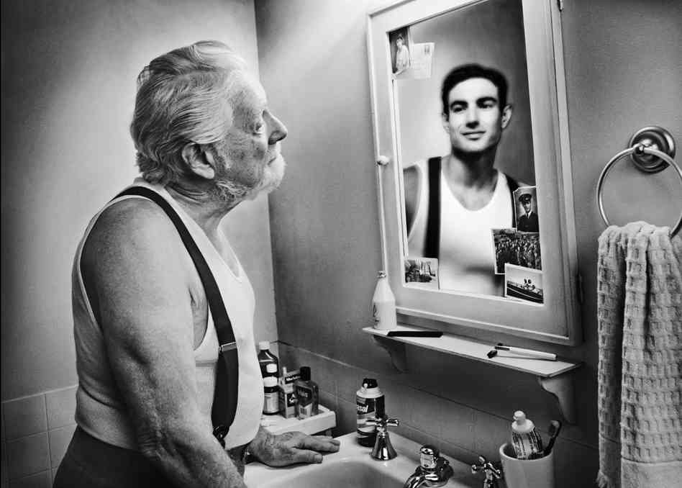



Reflect: me and technology

Slide 37
How does learning occur?

Slide 38

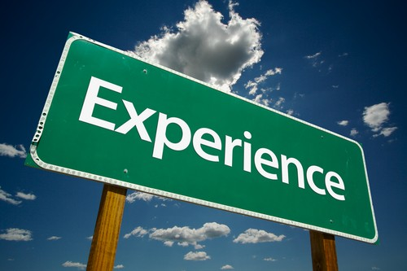

Literature
Session 1
Students learn and think in different ways:
Some students learn best through their visual ability of capturing information.
Some learn best by listening
Others learn best by moving – experiencing (Willingham et al., 2015)

Slide 39
How does learning occur cont..
While each student will vary on their strengths of the previously mentioned to capture knowledge, all students use those approaches to learn.
Audio
Text
Visual

Slide 40
Example
Online Test
Recorded lectures
Online discussions with marks
Video Assignment
Recorded Assignment
How DO I PREPARE FOR MY LECTURE

Slide 41

The buzz word, Blended learning

Slide 42
What is blended learning?
Nikolić et al (2015:2) simply define blended learning as: a teaching and learning approach that combines face-to-face classroom methods with online activities.

Slide 43
Blended learning contin..
Widely used in higher education
Offers an opportunity to use varied platforms to access learning and different innovative learning activities.
rethinking of the instructional design
the investment of additional time and effort in the design
trigger a shift toward a more active and learner-centered approach

Slide 44
Blended learning affordances
give you the possibility to adapt the learning materials to the students individual needs or preferences (Chandra &Watters, 2012).
blended learning might also be better able to meet the needs of the current generation of students, who are surrounded by computers in their daily life

Slide 45
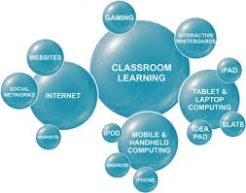
Using Blended learning as an approach
Understand yourself as a lecturer
Understand your context
Understand your students
Understand the learning objective

Slide 46

Understanding yourself as a lecturer
Fear of the unknown
Technology is for private use and does not spill into work life
Dedicating time to redefine how you conduct lecturers
Acknowledging the need for training
Networking and keeping contact with people who have the same objectives

Slide 47

Understand your context
What technology support does your institution have : LMS
What skills and interests do you have which you can use in the blended learning environment? (do you like blogging, listening to podcasts etc)
Does your institution have Wi-Fi?
Will the context enable you to create a Blended learning environment?

Slide 48

Understanding your student
Do your students have mobile phones/laptops/tablets
Are they able to access Wi-Fi on their devices?
Do they have technology skills?
How can you support them?

Slide 49
Understanding the learning objectives
Every learning activity you prepare as an educator has an objective
Technology enables you to achieve these objectives through multiple ways.
PLAN =PREPARE = ENJOY

Slide 50
Preparing for my lecture examples?

Slide 51
Blended Learning
Technology does not drive innovation the lecturer drives the innovation!

Slide 52
Summary
Understand your self- your fear, your likes and dislikes and training you need
Understand your student
Understand the context
Know your objective of the activity

Slide 53
Activity 2
Socrative challenge
Student Login: Room: TI7WK12
On your mobile devices login to :
https://www.socrative.com

Slide 54
References
Chandra, V., &Watters, J. J. (2012). Re-thinking physics teaching with web-based learning. Computers & Education, 58(1), 631–640.
Spanjers, I. A., Könings, K. D., Leppink, J., Verstegen, D. M., de Jong, N., Czabanowska, K., & Van Merriënboer, J. J. (2015). The promised land of blended learning: Quizzes as a moderator. Educational Research Review.
Willingham, D. T., Hughes, E. M., & Dobolyi, D. G. (2015). The Scientific Status of Learning Styles Theories. Teaching of Psychology, 42(3), 266-271.

Slide 55
The end…..
Ke a leboga
Enkosi
Thank you
Dankie
Niyabonga
Ro livhuwa

Slide 56

Questions

