Slide 1


Why do students tend to give common-sense responses in assessment tasks?
Lee Rusznyak
Botho University
Gaborone
28 November 2015

Slide 2

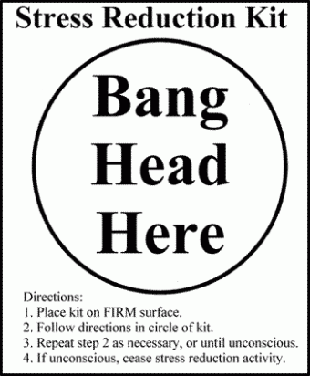
Assessing students’ work

Slide 3
Where do students struggle in their responses to assessment tasks?
Don’t always recognize what is required of them
Tendency to provide personal anecdotes to conceptual questions
Struggle to position their answers in relation to knowledge authorities in the field.
Struggle to understand what is expected of them within norms of academic reading and writing
(Shalem, Dison, Gennrich & Nkambule, 2013)

Slide 4
Assessment Research Project
Study prompted by a concern that student teachers seemed to struggle to understand expectations of the assessment tasks that involve understanding concepts and their application to real-world contexts.
Data:
Quantitative analysis of all assessment tasks given to a group of students in a year
Statistical analysis of students’ Grade 12 results and first year B Ed results
Interviews with first year students about their perceptions and experiences of school and university expectations and assessment

Slide 5
Research questions
How do the structure of application tasks
promote or constrain students’ acquisition of systematised educational knowledge?
promote or constrain students’ understanding of practice?
promote or constrain students’ understanding of context-based realities?

Slide 6
Study published:
Shalem, Y. & Rusznyak, L. 2013. Theory for teacher practice: a typology of application tasks in teacher education. South African Journal of Higher Education. 27 (5). 1118 – 1134.

Slide 7
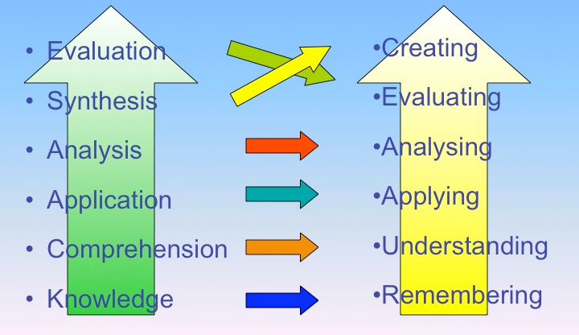
Bloom’s Taxonomy, 1956
Critique…
All thinking processes work with knowledge
Importance of knowledge is undervalued….

Slide 8
Taxonomy of Learning, Teaching and Assessing (2001)
More difficult ways of working with knowledge
6 | Create knowledge
5 | Evaluate knowledge
4 | Analyze knowledge
3 | Apply knowledge
2 | Understand knowledge
1 | Remember knowledge
Easier ways
of working with knowledge

Slide 9

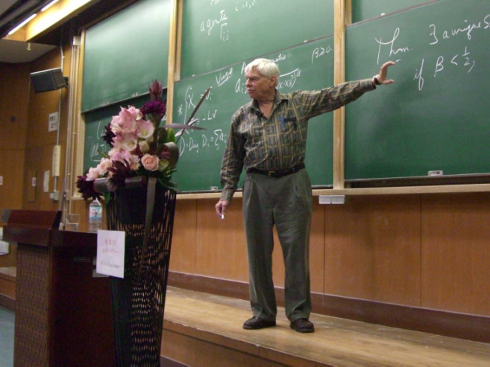

Teaching and learning involves
“making the strange, familiar….and the familiar, strange”
Novalis, German poet (1772-1801)

Slide 10
Making the strange, familiar
Becoming familiar with the existing state of knowledge about an object of study
Integrate new knowledge into one’s existing understanding
Making it ‘my own’
(Slominsky & Shalem, 2006)

Slide 11
Making the familiar, strange
Separating oneself from one’s ‘common-sense’ understanding of an object of study
Adopting conceptually-informed ideas to understand the object of study in ways that of new insights into what we thought we knew
(Slominsky & Shalem, 2006)

Slide 12
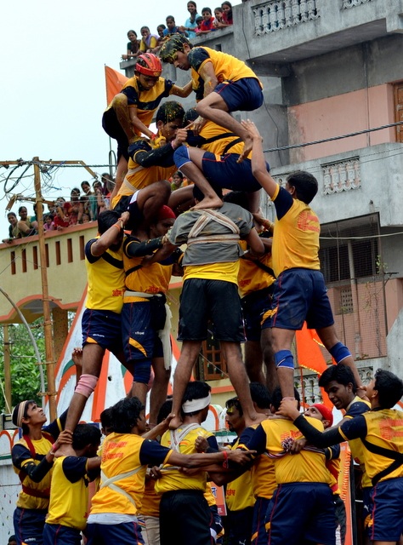
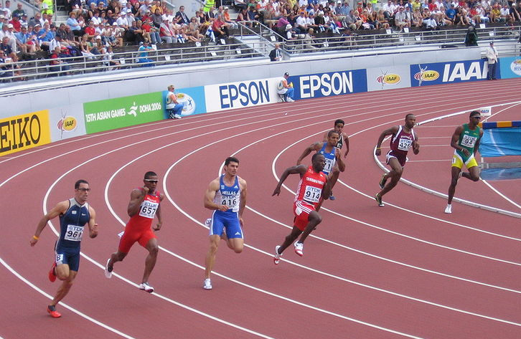
Knowledge structures
Vertical Knowledge
(e.g. Sciences)
Horizontal Knowledge
(e.g. Humanities)
(Bernstein, 2000)

Slide 13
Analysis of Assessment tasks
What are the conceptual objects are in the question?
Does the question reveal its knowledge structure to students?
Does the question ask students to articulate their understanding of the key concept?
Does the question ask students to draw on their personal observations, experience?
Does the question ask students to draw on their general knowledge of the wider world?
How many parts of the question?
How clearly are the parts demarcated?
What does each part require students to do with the knowledge?

Slide 14
Initial Findings
Often multiple concepts in a single question
Very few questions asked students to articulate their understanding of a concept / theory
Most questions required application to classroom, teaching practice, education in SA
…..How visible are the concepts in the assessment tasks?

Slide 15
How visibly are conceptual objects demarcated in application tasks?
Strongly demarcated
conceptual object
Weakly demarcated
conceptual object
Non- demarcated
conceptual object
Discrete ideas
Broad theoretical perspective
Concept specified and positioned within body of knowledge
Conceptual object alluded to but not specified
Notes:
Given that students have been used to drawing on their opinions and experiences to respond to assessment tasks, we need to ensure that the object of study is clear to them.
Use Bronfenbrenner’s nested ecological systems to discuss Nomsa’s development.

Slide 16
How visibly are practice-based contexts demarcated in application tasks?
Non- demarcated
contextual object
Strongly demarcated
Contextual object
Weakly demarcated
contextual object
Link to case study; artefact of practice; simulated practice based event
Link to education/ schooling broadly
Link to unspecified personal experiences/ observations
Notes:
Given that students have been used to drawing on their opinions and experiences to respond to application tasks, we need to ensure that the object of study is clear to them.
Use Bronfenbrenner’s nested ecological systems to discuss Nomsa’s development.

Slide 17
Typology of Application tasks
 |  | CONCEPTUAL OBJECT OF STUDY
 |  | Strongly demarcated | Weakly demarcated | Non demarcated
Practice based context | Strongly demarcated | Category A | Category D | Category G
 | Weakly demarcated | Category B | Category E | Category H
 | Non demarcated | Category C | Category F | Category I

Slide 18
Typology of Application tasks
 |  | CONCEPTUAL OBJECT OF STUDY
 |  | Strongly demarcated | Weakly demarcated | Non demarcated
Practice based context | Strongly demarcated | Category A | Category D | Category G
 | Weakly demarcated | Category B | Category E | Category H
 | Non demarcated | Category C | Category F | Category I

Slide 19
Category A: Strongly demarcated concept linked to strongly demarcated practice-based context
a) Explain each of the following terms that constructivist theorists use in their explanations of how children learn: Adaptation; schema; assimilation and accommodation;
b) Compare and contrast four stages described by Piaget to explain how children develop cognitively.
c) What evidence in the lesson transcript (provided) suggests that the teacher has considered the cognitive developmental stage of Grade 4 learners in her explanation of ‘space’?
Concepts need to be clearly understood in their own right before they can be applied as a lens to gain insights into practice
Notes:
This kind of assessment tasks suggest that concepts need to be clearly understood before they can be applied, and that a theory should be understood as an organizing framework that has its own vocabulary, internal structure, hierarchical relations and boundaries. The status of the theory, its criteria of truth and stability of claims is not in question (as would be expected in first year assessment tasks). Constrained – inferences are well guided
by well demarcated concepts

Slide 20
Typology of Application tasks
 |  | CONCEPTUAL OBJECT OF STUDY
 |  | Strongly demarcated | Weakly demarcated | Non demarcated
Practice based context | Strongly demarcated | Category A | Category D | Category G
 | Weakly demarcated | Category B | Category E | Category H
 | Non demarcated | Category C | Category F | Category I

Slide 21
Category B: Strongly demarcated concept linked to weakly bounded practice-based context
According to Durkheim, schools play an important role in maintaining social order in modern industrial societies.
a) Discuss the functionalist perspective and include relevant criticisms of the theory in your discussion.
b) Explain why this theory is important for understanding the role of education in South Africa during apartheid.
Concepts need to be clearly understood before they can be applied
Students required to select what to include/exclude from their unsystematised personal experiences.
Notes:
While the first part of the question asks student to discuss and evaluate a sociological theory in its own right, the latter part expects students to reconsider their experience in a non-intuitive way, and be able to impose some order on their experience, using the theoretical perspective offered in the question. It is much more difficult to do this when the conceptual object is posited as a general object, without specification of concepts and relation.

Slide 22
Category C: Strongly demarcated concept linked to non-demarcated practice-based context
According to Durkheim, schools play an important role in maintaining social order in modern industrial societies.
a) Discuss the functionalist perspective and include relevant criticisms of the theory in your discussion.
b) Based on your personal experience as a learner, explain how this claim helps you understand your past experiences of schooling.
Concepts need to be clearly understood before they can be applied
Students required to select what to include/exclude from their unsystematised personal experiences.
Notes:
While the first part of the question asks student to discuss and evaluate a sociological theory in its own right, the latter part expects students to reconsider their experience in a non-intuitive way, and be able to impose some order on their experience, using the theoretical perspective offered in the question. It is much more difficult to do this when the conceptual object is posited as a general object, without specification of concepts and relation.

Slide 23
Typology of Application tasks
 |  | CONCEPTUAL OBJECT OF STUDY
 |  | Strongly demarcated | Weakly demarcated | Non demarcated
Practice based context | Strongly demarcated | Category A | Category D | Category G
 | Weakly demarcated | Category B | Category E | Category H
 | Non demarcated | Category C | Category F | Category I

Slide 24
Category E: Weakly demarcated concept linked to weakly demarcated practice-based context
How can teachers provide ‘scaffolds’ to support learning?
Draw on your experiences / observations during the recent Teaching Practicum to illustrate your answer.
Theory is a tool that enables practitioners to do something within practice-based contexts
Notes:
This kind of assessment tasks suggest that concepts need to be clearly understood before they can be applied, and that a theory should be understood as an organizing framework that has its own vocabulary, internal structure, hierarchical relations and boundaries. The status of the theory, its criteria of truth and stability of claims is not in question (as would be expected in first year assessment tasks). Constrained – inferences are well guided
by well demarcated concepts

Slide 25
Typology of Application tasks
 |  | CONCEPTUAL OBJECT OF STUDY
 |  | Strongly demarcated | Weakly demarcated | Non demarcated
Practice based context | Strongly demarcated | Category A | Category D | Category G
 | Weakly demarcated | Category B | Category E | Category H
 | Non demarcated | Category C | Category F | Category I

Slide 26
Category I: Non-demarcated concept linked to non-demarcated practice-based context
You have recently spent a week observing teachers in schools. Based on your readings and observations describe what comprises high quality practice that will enable the teacher to meet the aims of elementary school teaching.
What criteria should be used to judge the quality of teaching?
What examples from observations might be relevant?
Commonsense type of response encouraged
Notes:
The students would first need to determine what criteria to impose on their observations, or alternatively decide what aspects of practice that emerge inductively from their observations are noteworthy in terms of possible concepts of good teaching. Once students have established some criteria to determine what aspects of good teaching to be included/excluded from this discussion, they would then need to extract some relevant and appropriate observations to support an argument. When the concept is invisible and the practice-based context is fuzzy there is a good chance that students will resort to common-sense link between the two object.

Slide 27
Implications for teaching & learning
Clearly demarcated conceptual objects provide conditions of possibility for students to develop systematised knowledge.
In order to enhance students’ understanding of what an application task requires them to do, the concept that students are required to engage with needs to be positioned in relation to a body of knowledge and the practice-based context they are expected to reflect on (or apply their knowledge to).
Tasks with a less visible conceptual object encourage weak / beginner students to provide common-sense responses.
Consider epistemic implications and pedagogic priorities when setting application tasks: when? Why?

Slide 28
Analysing assessment tasks
1. Parts of the question
  1.1 How many parts of the question?
  2. How clearly are those parts demarcated?
2. Conceptual Objects of Study
  2.1. What are the conceptual objects are in the question?
  2.2. Is the conceptual object located in a broader theory / paradigm?
  2.3. To what extent does the question reveal its knowledge structure to students?
  2.4. Does the question ask students to articulate their understanding of the key concept for its own sake?

Slide 29
Analysing assessment tasks
3. Working with knowledge
3.1. What does the task require that students to do with the knowledge?
3.2. Where there is application to real world contexts:
    3.2.1. How bounded does the question make the real-world context?
    3.2.2. Does answering the question require that the students draw on their previous experiences?
    3.2.3. Does the question ask students to draw on their personal observations or opinions?
    3.2.4. Does answering the question require the student to have a good knowledge of a context beyond the scope of the course?

Slide 30
Strengthening assessment tasks
4. Where appropriate, how could the assessment question/s be reworked so that:
  Parts of the question are more clearly demarcated?
  Fewer concepts are included in the question?
  A conceptual object of study is made more visible?
  Articulation of an understanding of the concept precedes its application?
  The concept is located more explicitly within its theoretical paradigm?
  Students have to make fewer knowledge selection choices?

Slide 31
Thank you
Dr. Lee Rusznyak
Lee.Rusznyak@wits.ac.za
In association with the UNESCO Chair Forum in Teacher Education for Diversity and Development at the School of Education, University of the Witwatersrand, South Africa.

